Slide 1
Machine Learning from Scratch
Hacking ML without Libraries

Slide 2
Section I Overview

Slide 3
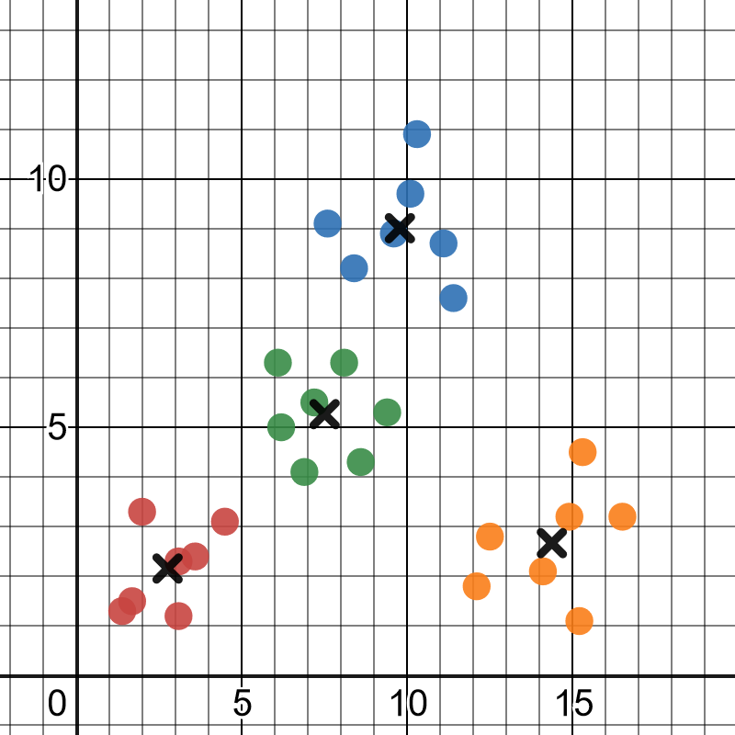
Agenda
Here is what we will do for the next 3 hours:
1
Introduction and what to expect
2
Linear Regression and K-Means Clustering
3
Text classification with Naive Bayes
4
Binary classification with Logistic Regression
5
Decision trees and Random Forests
6
Classification with Neural Networks

Slide 4
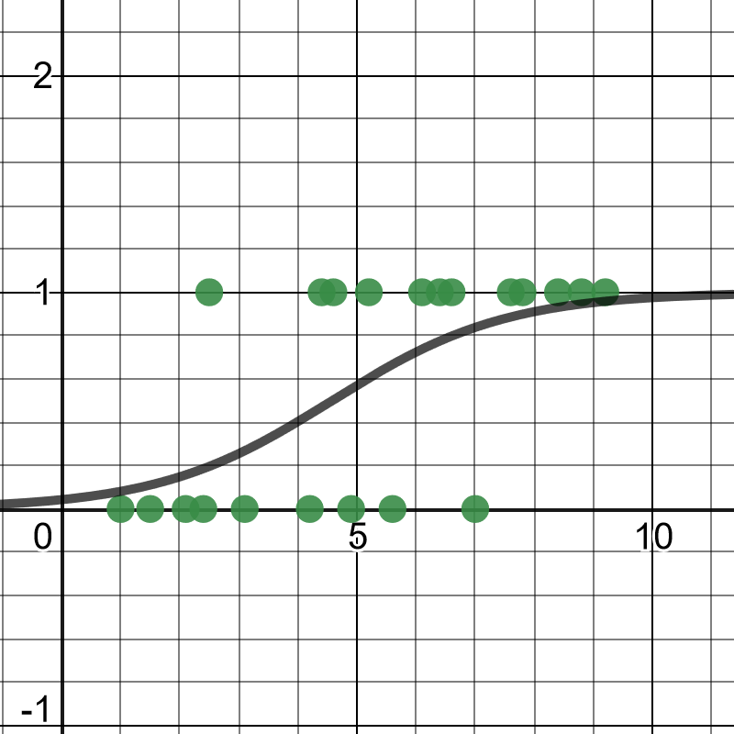
What to Expect
How to build machine learning algorithms from scratch to develop intuition and understanding.
Remove some unnecessary barriers to get started with machine learning:
No calculus or partial derivatives
Little to no linear algebra
All Python code
While we may take some unconventional approaches, we will be doing actual machine learning.

Slide 5
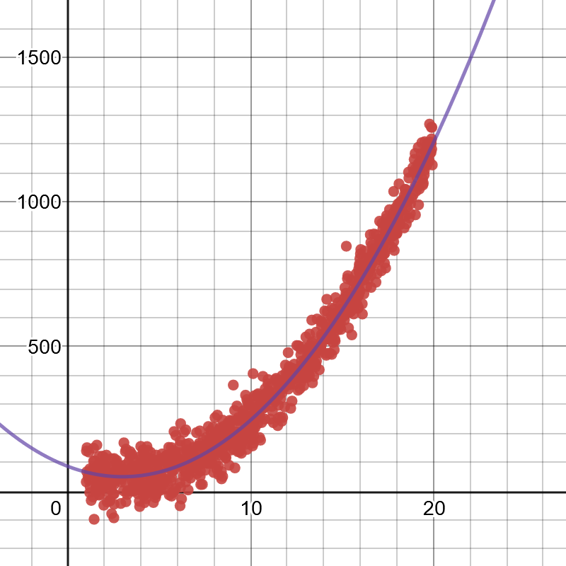
What Not to Expect
We will not be building state-of-the-art machine learning algorithms especially in regards to performance.
We will primarily be using vanilla Python to build these algorithms, which has a high performance cost.
Linear algebra libraries like NumPy can be used to gain efficiencies, and I will strive to include these alternate implementations in the code files.
We will not be validating and analyzing our machine learning models formally, and instead focus on building the ML algorithms.

Slide 6
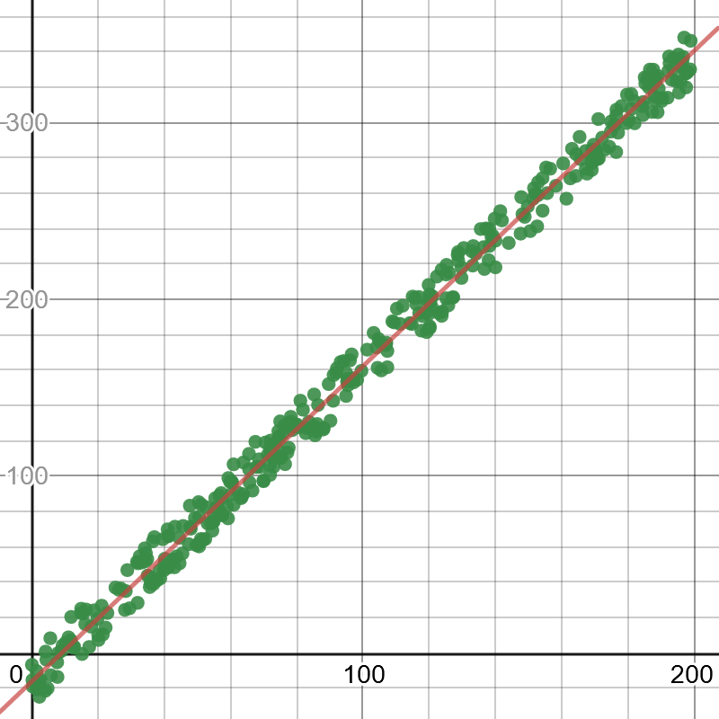
What Not to Expect
For model fitting we will not be using conventional methods like gradient descent and calculus.
Instead we will use simple hill-climbing algorithms.
Optimization is optimization regardless if it is hill-climbing, simulated annealing, genetic algorithms, or gradient descent.
Hill climbing is the simplest optimization algorithm to implement, and works remarkably well for basic machine learning.

Slide 7
Machine Learning vs Optimization vs AI
Machine Learning
Optimization
Loss Minimization
Artificial Intelligence

Slide 8
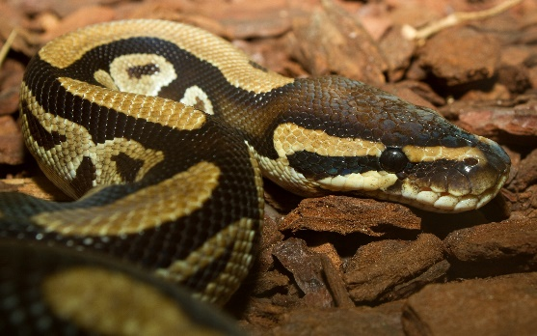


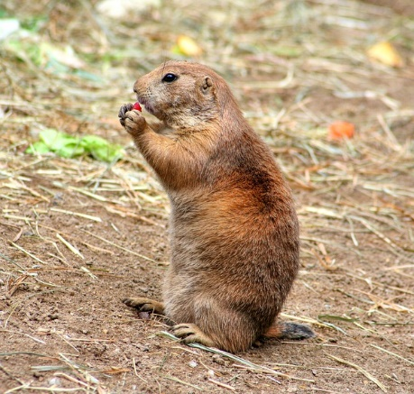
Programming Languages and Performance
We will build some exciting from-scratch models in Python.
Python is a great, easy-to-learn language, but it is really slow because it is dynamically typed and interpreted.
Pure Python models will struggle to scale, even with modestly sized data sets of thousands of records.
This is going to be the cost of learning machine learning without libraries like NumPy.
NumPy is necessary to scale Python because it is efficiently written in C, but it is also esoteric and distracting for first-time learners.

Slide 9
Programming Languages and Performance
Java, Kotlin, Scala, Swift, C, C++, C#, Go, and other statically typed/compiled languages will perform much faster than Python.
You will have more success scaling machine learning algorithms built from scratch with these platforms.
If you truly enjoy building machine learning algorithms from scratch, please learn one of these platforms!
At this level with our toy examples, Python is going to work just fine.

Slide 10
Section II Linear Regression and K-Means Clustering

Slide 11
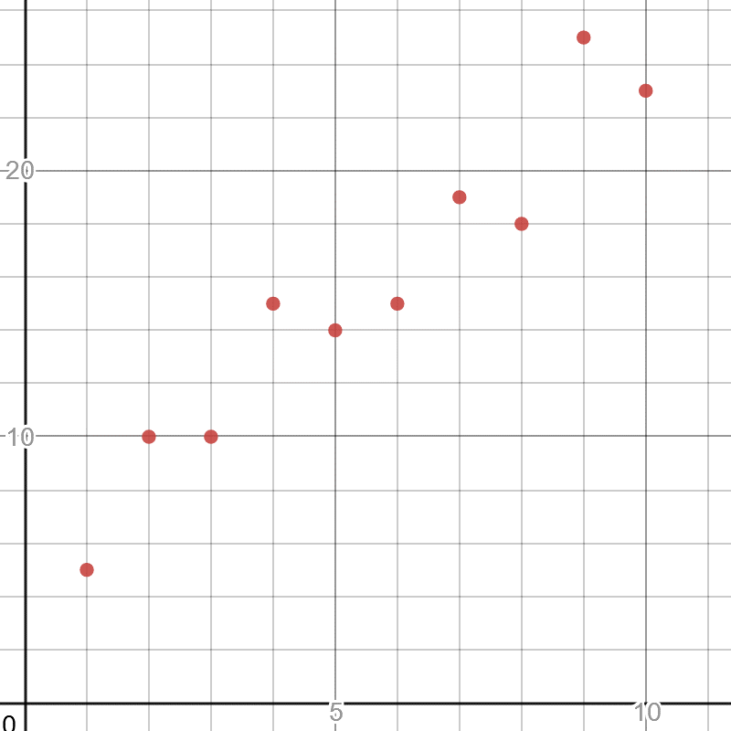
Simple Linear Regression
In practicality, machine learning is often about two tasks: regression and classification.
Let’s start with regression, particularly the simplest one called linear regression which finds the best fit straight line through some points.
Here is a simple 2-dimensional plot of two variables, where x is independent and y is dependent.
Independent variables are observed values that will serve as inputs into a function.
Dependent variables are the outputted variables derived off the independent variables.
https://www.desmos.com/calculator/fmhotfn3qm

Slide 12
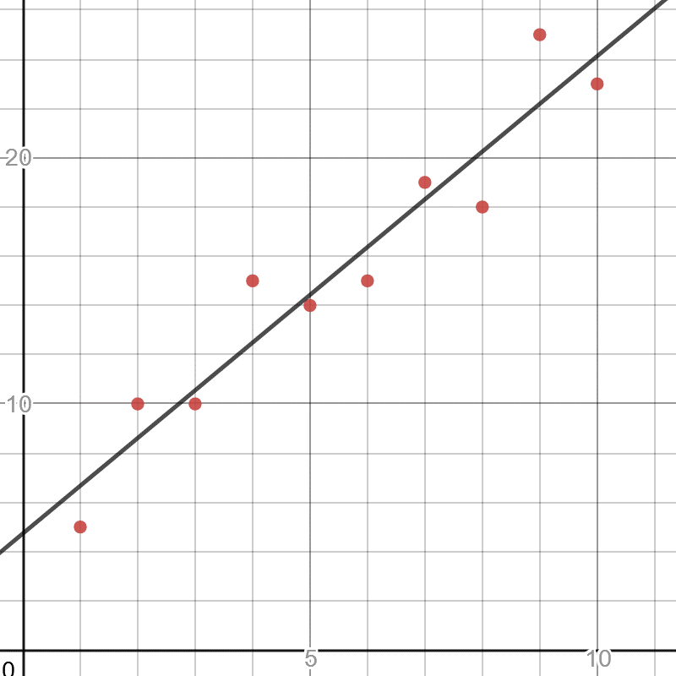
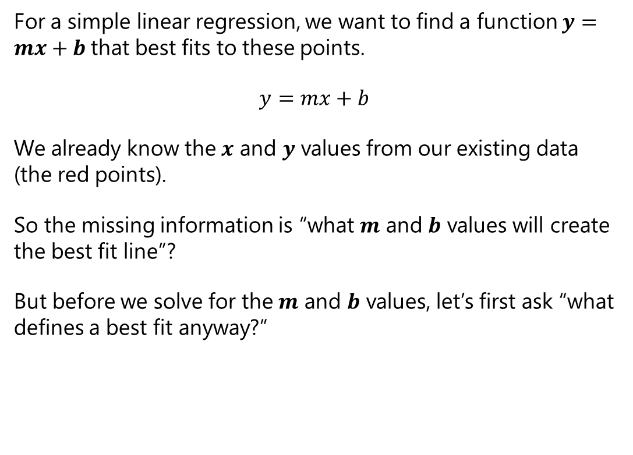
Simple Linear Regression
For a simple linear regression, we want to find a function $y=mx+b$that best fits to these points.
$$y=mx+b$$
We already know the $x$ and $y$ values from our existing data (the red points).
So the missing information is “what $m$ and $b$ values will create the best fit line”?
But before we solve for the $m$ and $b$ values, let’s first ask “what defines a best fit anyway?”
https://www.desmos.com/calculator/fmhotfn3qm

Slide 13

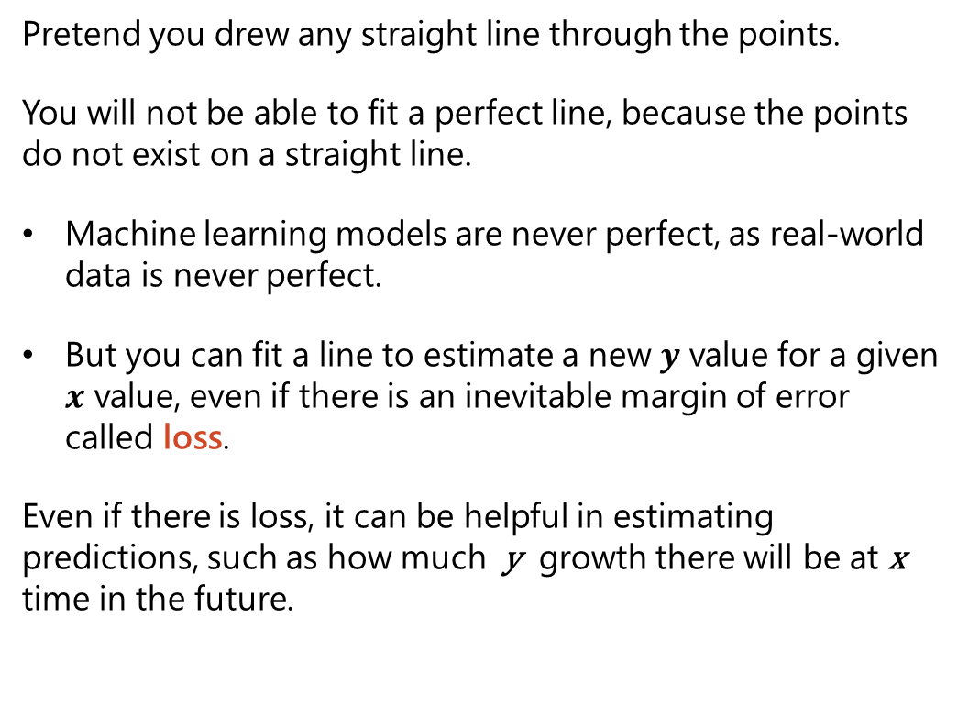
Simple Linear Regression
Pretend you drew any straight line through the points.
You will not be able to fit a perfect line, because the points do not exist on a straight line.
Machine learning models are never perfect, as real-world data is never perfect.
But you can fit a line to estimate a new $y$ value for a given $x$ value, even if there is an inevitable margin of error called loss.
Even if there is loss, it can be helpful in estimating predictions, such as how much y growth there will be at x time in the future.
https://www.desmos.com/calculator/fmhotfn3qm

Slide 14
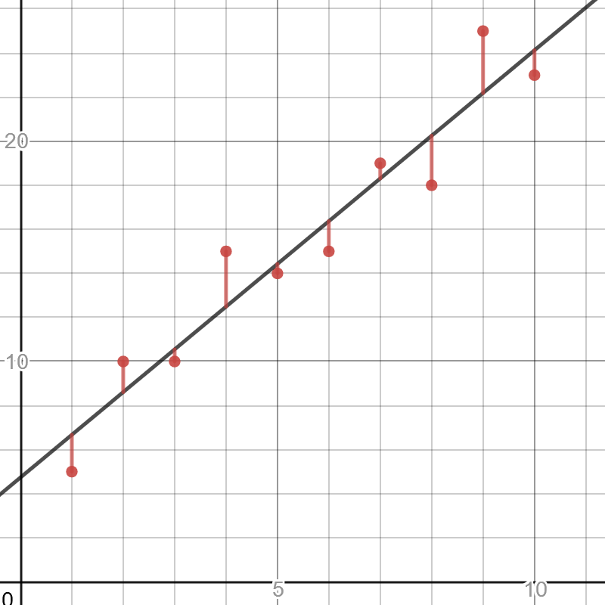
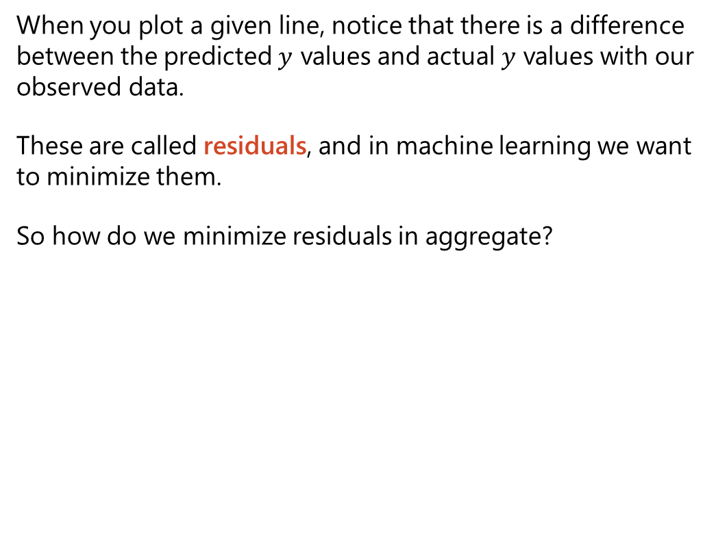
Simple Linear Regression
When you plot a given line, notice that there is a difference between the predicted $y$ values and actual $y$ values with our observed data.
These are called residuals, and in machine learning we want to minimize them.
So how do we minimize residuals in aggregate?
https://www.desmos.com/calculator/fmhotfn3qm

Slide 15
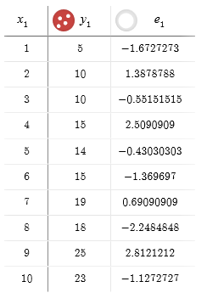
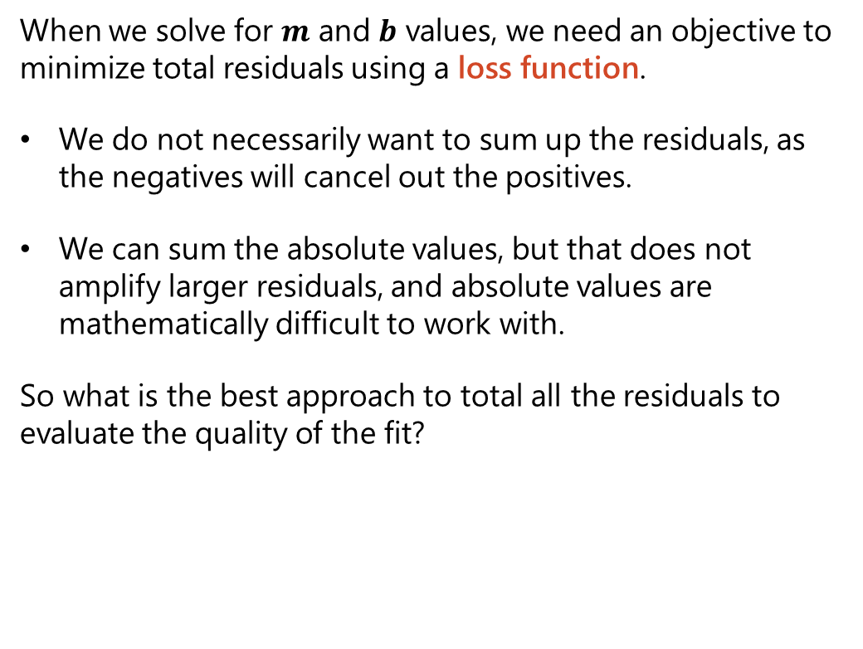
Sum of Least Squares
When we solve for $m$ and $b$ values, we need an objective to minimize total residuals using a loss function.
We do not necessarily want to sum up the residuals, as the negatives will cancel out the positives.
We can sum the absolute values, but that does not amplify larger residuals, and absolute values are mathematically difficult to work with.
So what is the best approach to total all the residuals to evaluate the quality of the fit?

Slide 16
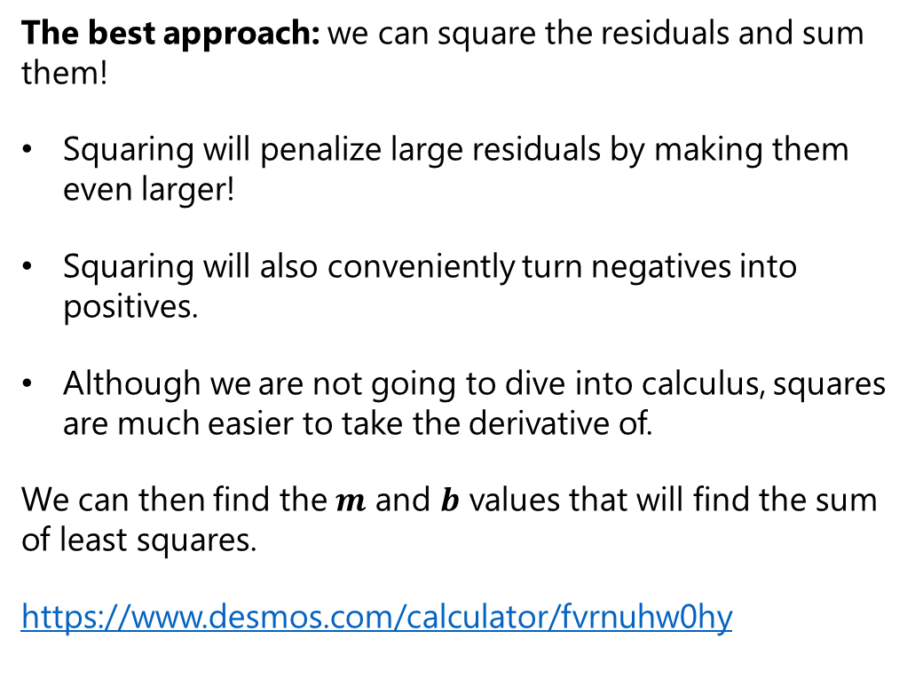
Sum of Least Squares
The best approach: we can square the residuals and sum them!
Squaring will penalize large residuals by making them even larger!
Squaring will also conveniently turn negatives into positives.
Although we are not going to dive into calculus, squares are much easier to take the derivative of.
We can then find the $m$ and $b$ values that will find the sum of least squares.
https://www.desmos.com/calculator/fvrnuhw0hy

Slide 17
Calculating Sum of Squares

Slide 18
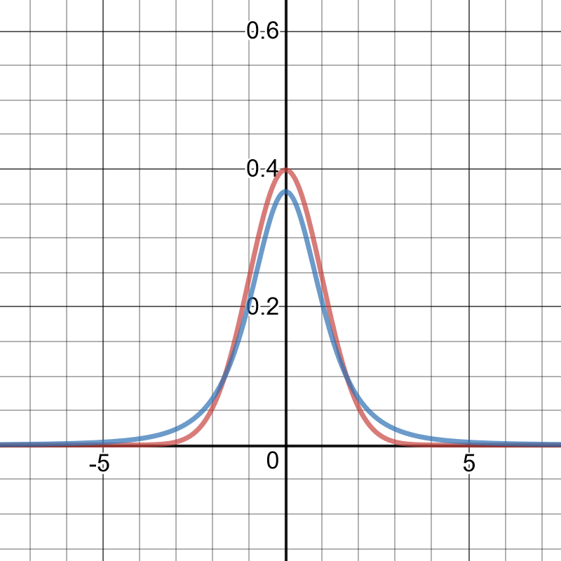
Solving for a Fit
Now that we have a loss function (the sum of squared residuals), how do we find the m and b values to minimize it?
We randomly increase/decrease m and b with random values from a standard normal distribution, or even better a T-Distribution which has fatter tails.
Fatter tails = more smaller/larger values = more diverse moves.
We can use these random adjustments to m and b as our moves in hill climbing.
Normal distribution
T-distribution
https://www.desmos.com/calculator/xm56tvvalh

Slide 19

Hill Climbing – A Simple Optimization Algorithm
Start with a random or initial solution, even if it is poor quality.
Repeat the following steps for a number of iterations and/or until the solution cannot improve anymore.
Select a random part of the solution and change it.
If that results in an improvement, keep it.
1
2

Slide 20
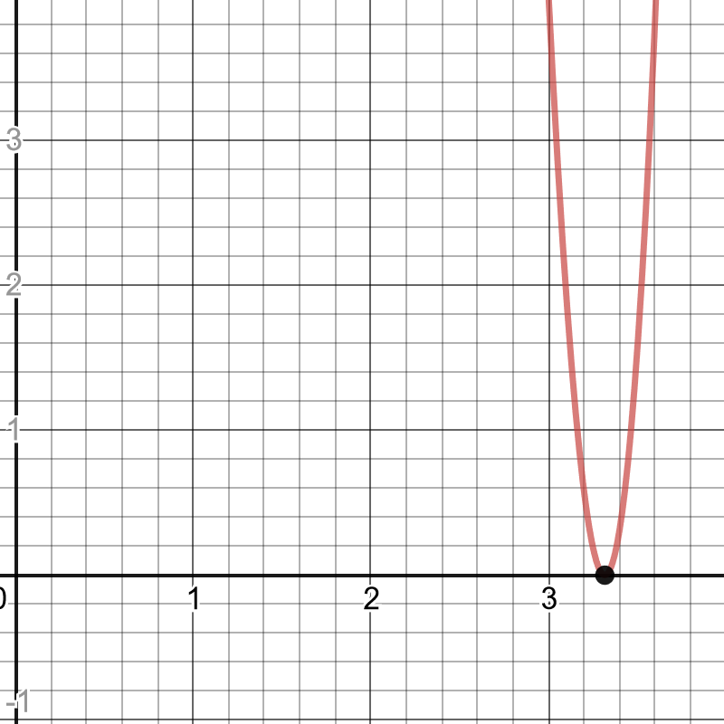
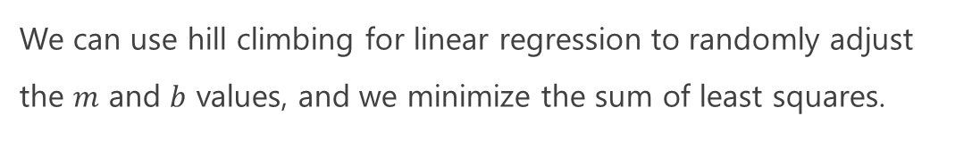
Hill Climbing to Find a Square Root
import numpy as np # Use hill climbing to estimate a square root value = 11.0 sqrt_candidate = value / 2.0 for i in range(100000): adjust = np.random.normal() new_candidate = sqrt_candidate + adjust if (value - sqrt_candidate ** 2) ** 2 > (value - new_candidate ** 2) ** 2: sqrt_candidate = new_candidate print(sqrt_candidate) # prints 3.316622346827584
We can use hill climbing for linear regression to randomly adjust the $m$ and $b$ values, and we minimize the sum of least squares.

Slide 21
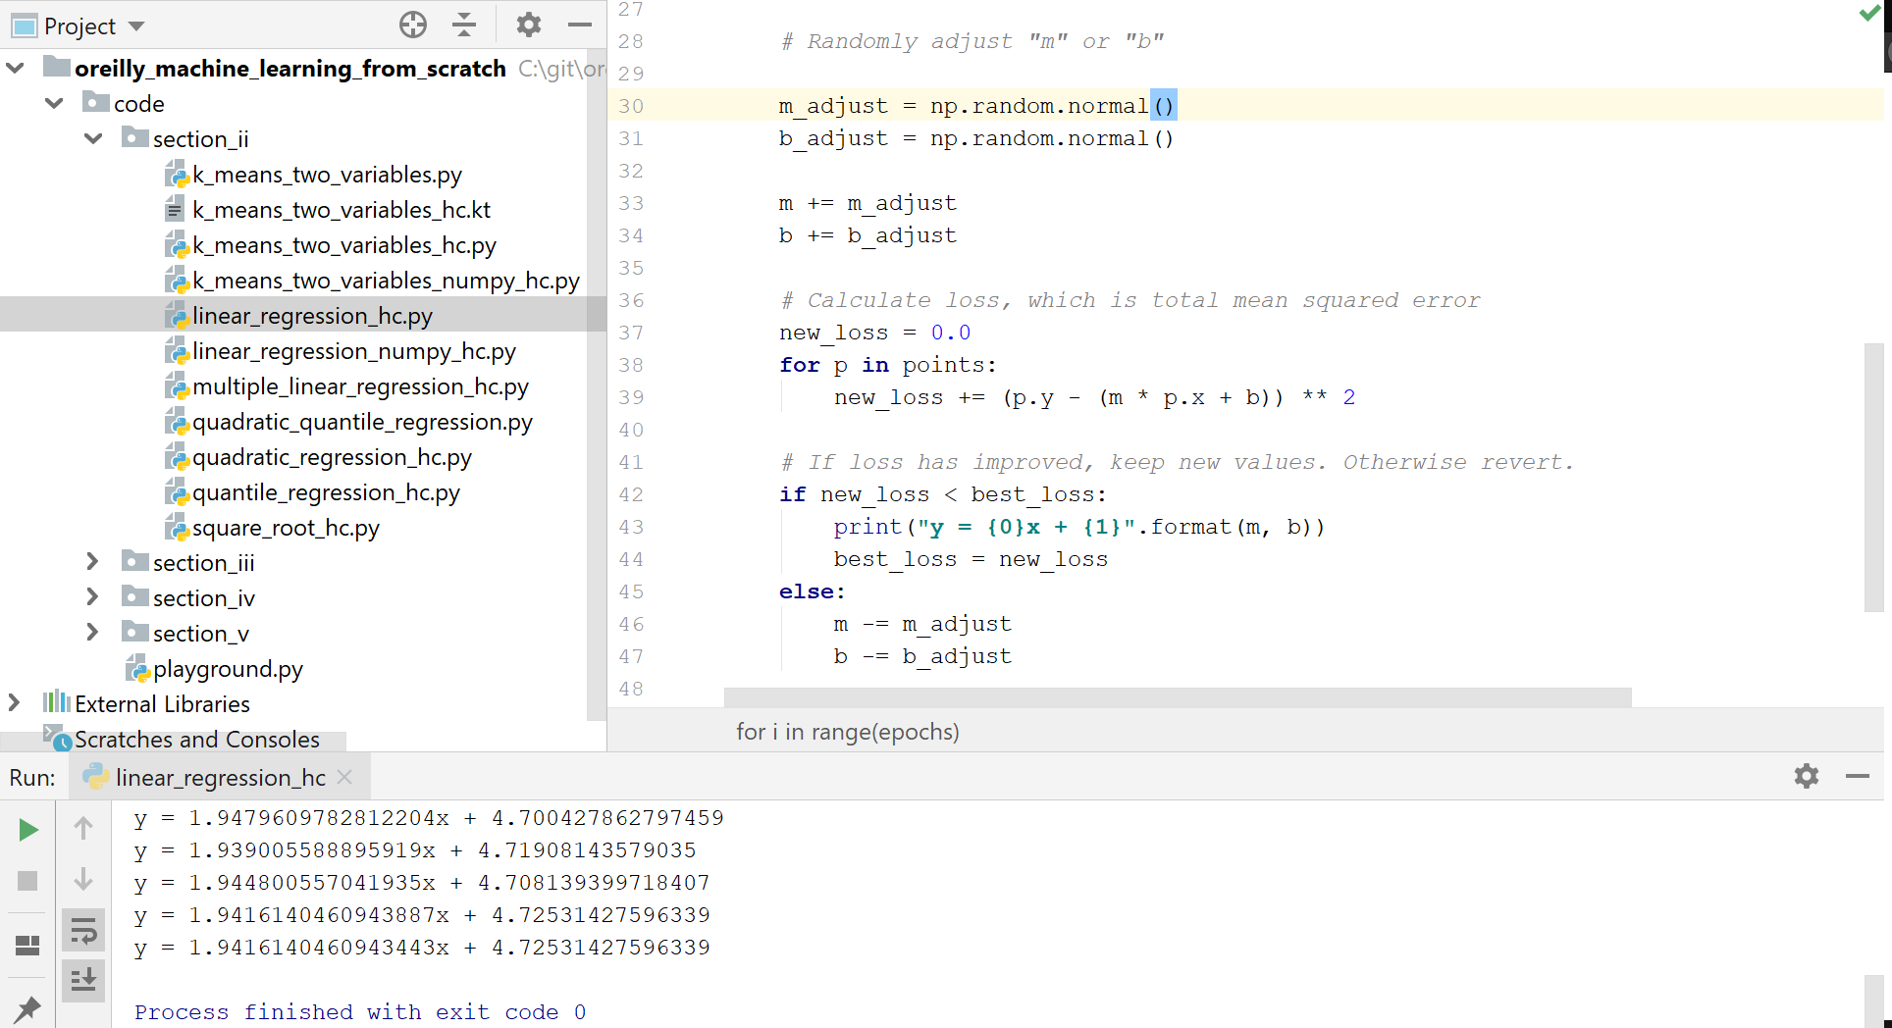
Hands-On: Simple Linear Regression

Slide 22
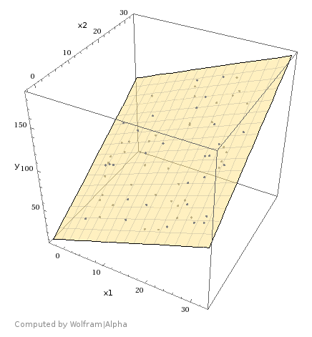
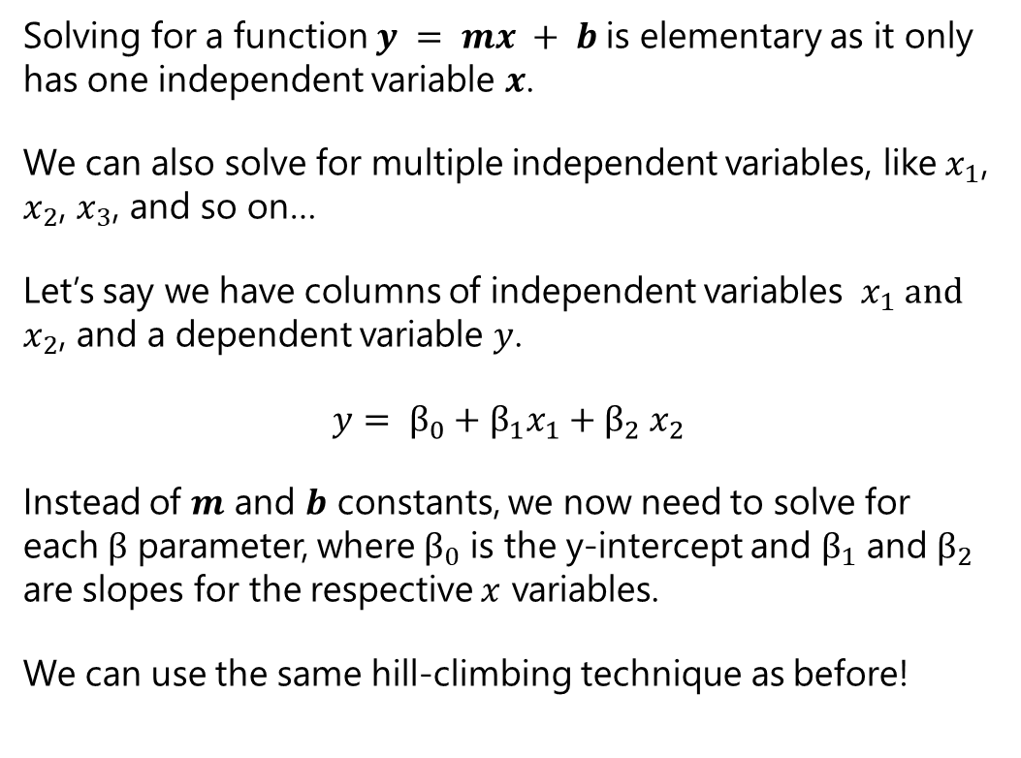
Multiple Linear Regression
Solving for a function $y = mx + b$is elementary as it only has one independent variable $x$.
We can also solve for multiple independent variables, like${ x}_{1}$, $x_{2}$, $x_{3}$, and so on…
Let’s say we have columns of independent variables ${ x}_{1} and$ $x_{2}$, and a dependent variable $y$.
$$y= β_{0}+β_{1}x_{1}{+ β}_{2}x_{2}$$
Instead of $m$ and $b$ constants, we now need to solve for each $β$ parameter, where $β_{0}$ is the y-intercept and $β_{1}$ and $β_{2}$ are slopes for the respective $x$ variables.
We can use the same hill-climbing technique as before!

Slide 23
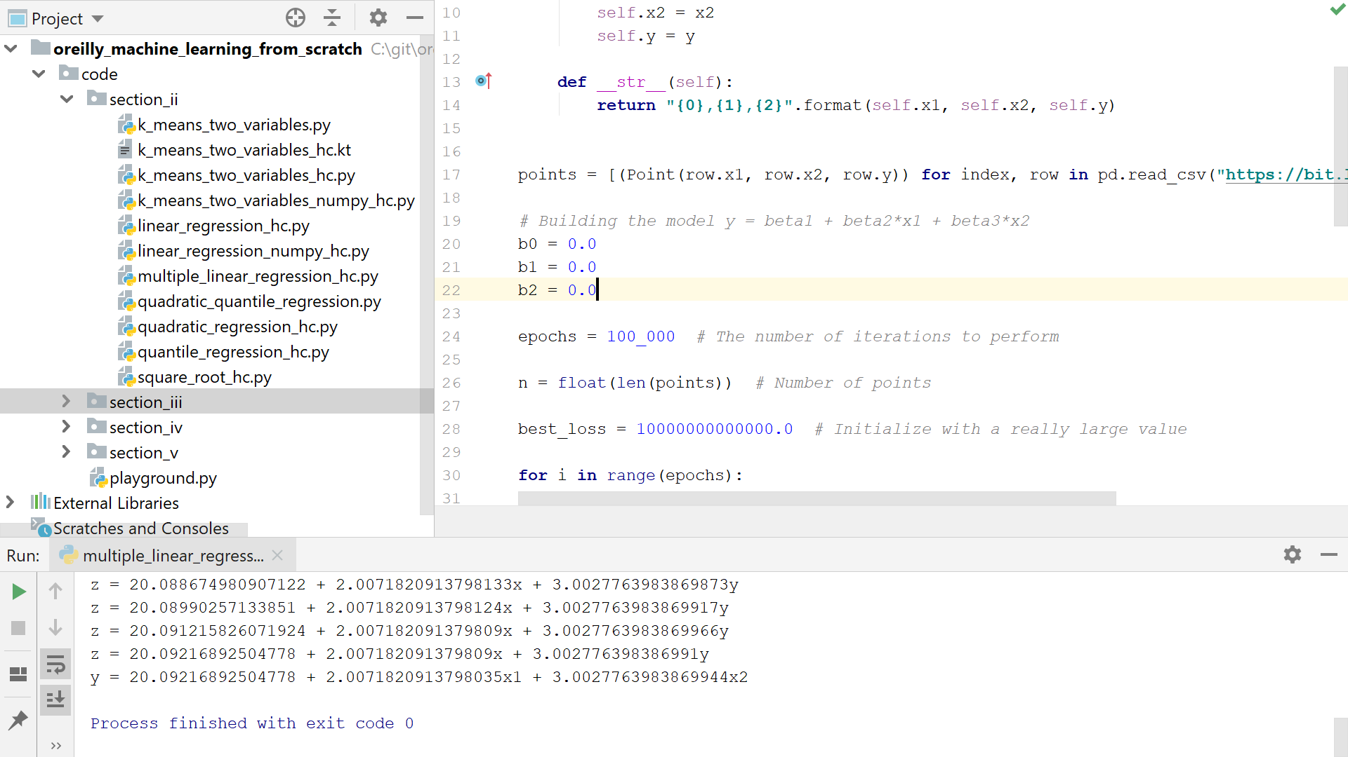
Hands-On: Multiple Linear Regression

Slide 24
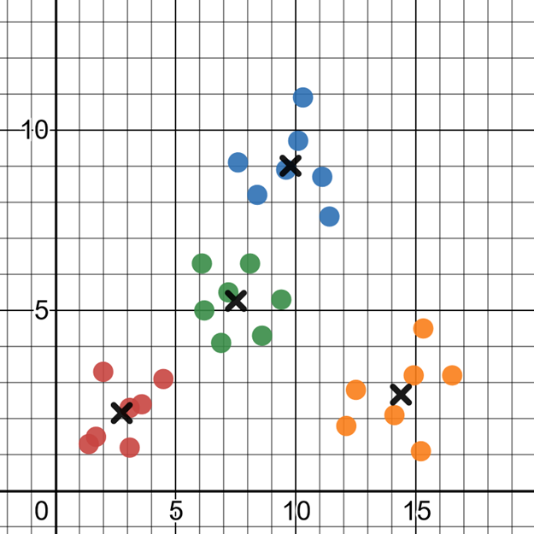
K-Means Clustering
Taking our exploration of machine learning with hill-climbing further, let’s talk about k-means clustering!
K-means clustering groups up points based on a specified number of centroids.
A centroid is a best-fit center for a cluster of points.
To the right is some data, and we can easily eyeball there are approximately 4 groups of points.

Slide 25
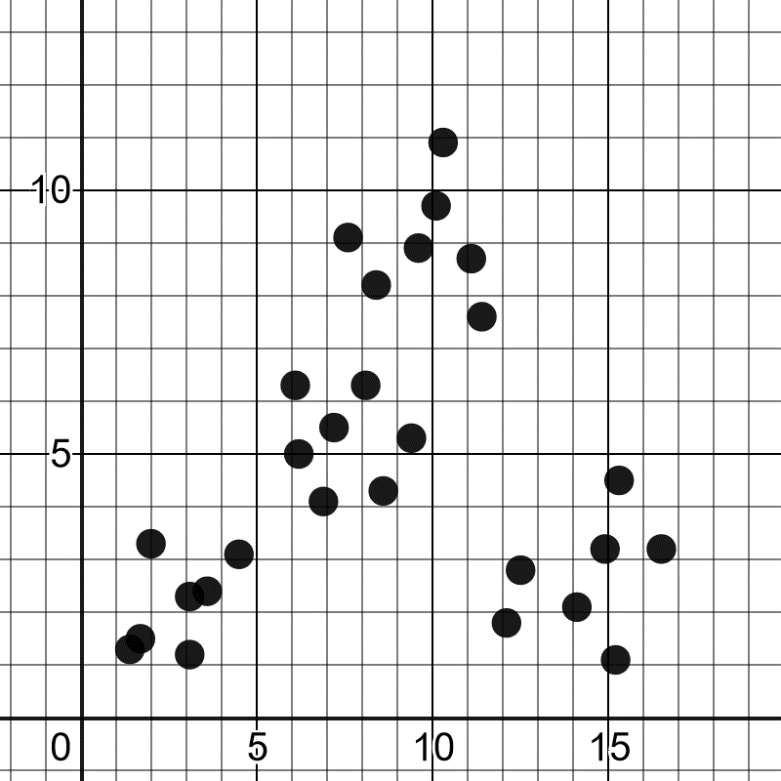
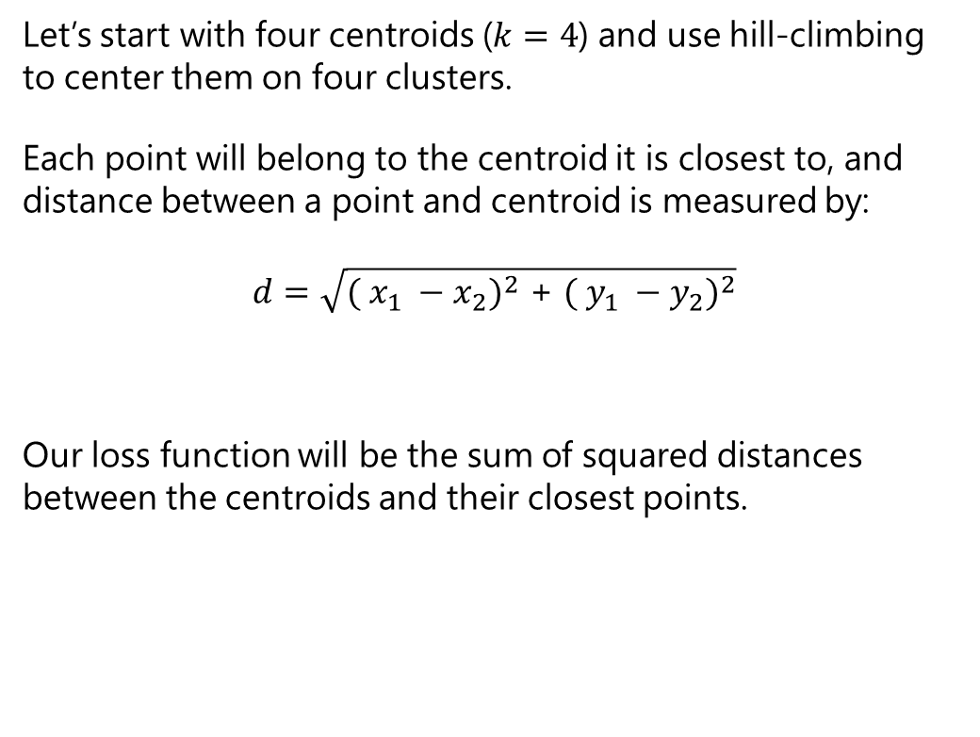
K-Means Clustering
Let’s start with four centroids ($k=4$) and use hill-climbing to center them on four clusters.
Each point will belong to the centroid it is closest to, and distance between a point and centroid is measured by:
$$d=\sqrt{{( x_{1} −x_{2})}^{2}\text{ +} {( y_{1} −y_{2})}^{2}}$$
Our loss function will be the sum of squared distances between the centroids and their closest points.

Slide 26
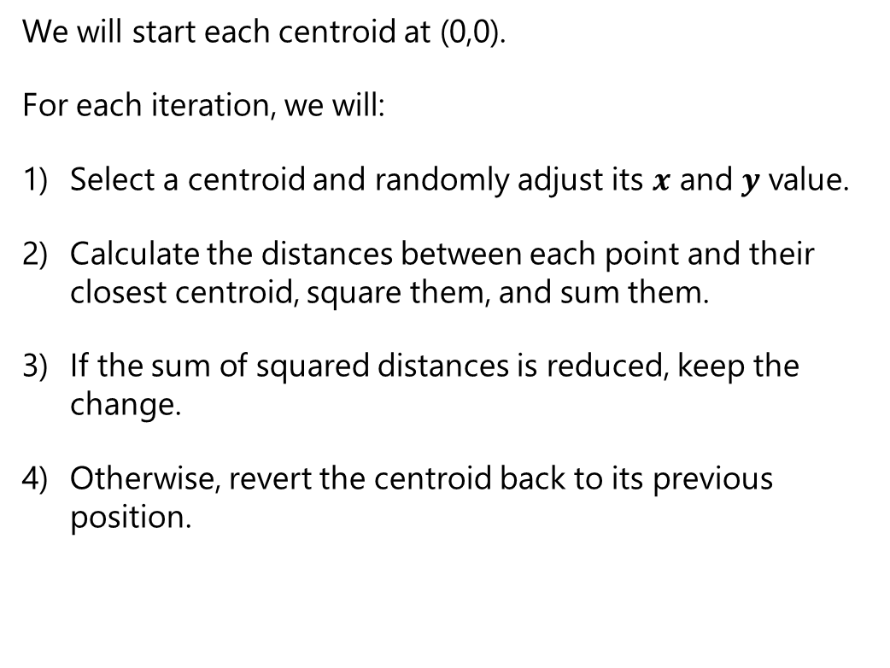
K-Means Clustering
We will start each centroid at (0,0).
For each iteration, we will:
Select a centroid and randomly adjust its $x$ and $y$ value.
Calculate the distances between each point and their closest centroid, square them, and sum them.
If the sum of squared distances is reduced, keep the change.
Otherwise, revert the centroid back to its previous position.
1
2
3
4

Slide 27
Hands-On: K-Means Clustering

Slide 28
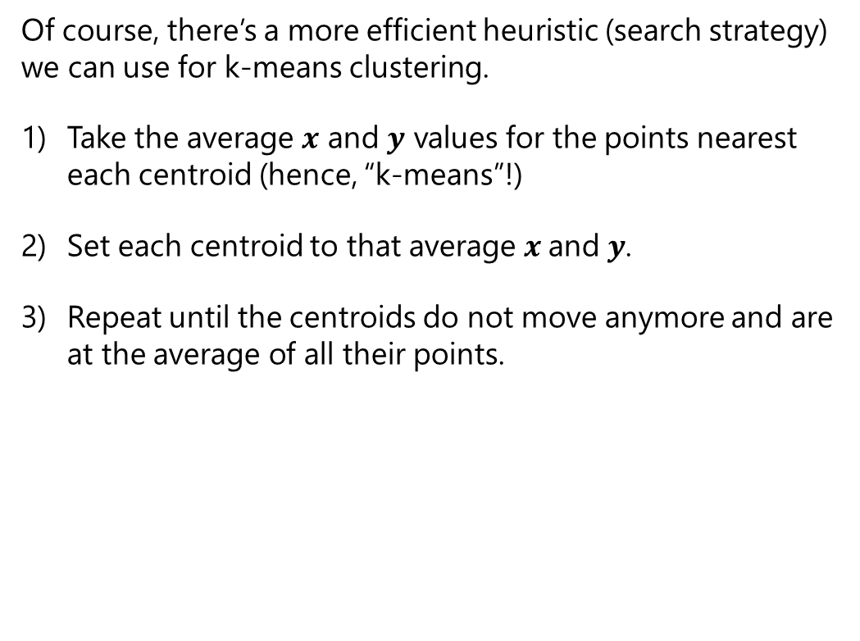
K-Means Clustering
Of course, there’s a more efficient heuristic (search strategy) we can use for k-means clustering.
Take the average $x$ and $y$ values for the points nearest each centroid (hence, “k-means”!)
Set each centroid to that average $x$and $y$.
Repeat until the centroids do not move anymore and are at the average of all their points.
1
2
3

Slide 29
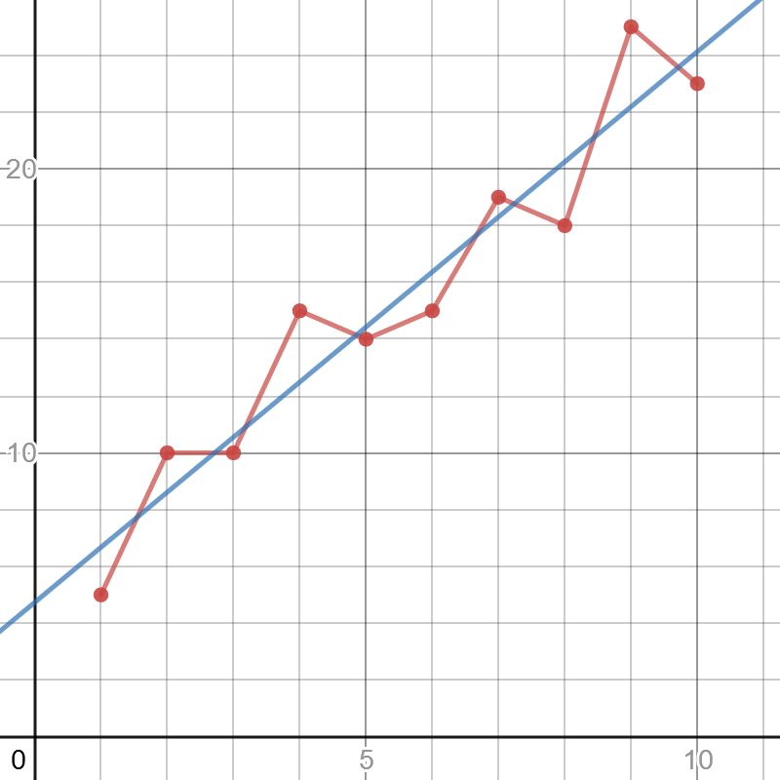
A Note About Overfitting
We are not going to focus too much on validating and analyzing machine learning models, but we should at least mention overfitting.
Overfitting means that our ML model works well with the data it was trained on but fails to predict correctly with new data.
This can be due to many factors, but a common cause is the sampled data does not represent the larger population and more data is needed.
The red line has high variance, meaning its predictions are sensitive to outliers and therefore can vary greatly.
The blue line has high bias, meaning the model is less sensitive to outliers because it prioritizes a method (maintaining a straight line) rather than bend and respond to variance.
The red line to the right is likely overfitted (high variance, low bias), but the blue linear regression line (low variance, high bias) is less likely to be overfit.
https://www.desmos.com/calculator/wmwfolbvdk

Slide 30

A Note About Overfitting
Linear regression is a highly biased method and is resilient to overfitting.
There are other remedies to mitigate overfitting, the most basic being separating training data and test data.
The model is fit to the training data, and then is tested with the test data.
If the test data performs poorly compared to the training data, there is a possibility of overfit (or just no correlation altogether).
You can also try to train with more data as well as utilize cross-validation, regularization, bagging, boosting, and other techniques.

Slide 31

A Note About Normalization
Normalization is another topic we do not have time to explore deeply in this 4-hour class but should at least get mentioned.
Normalization is scaling and converting the values of each variable, so they are relatively close together.
Imagine you had a variable age whose values typically range in 0-99.
But you had another variable income that typically ranges from 30,000 to 1,000,000.
Because these ranges are so drastically different, fitting a model is not going to be productive until you transform them somehow.
There are a variety of techniques you can employ from linear scaling to fitting to a standard normal distribution.

Slide 32
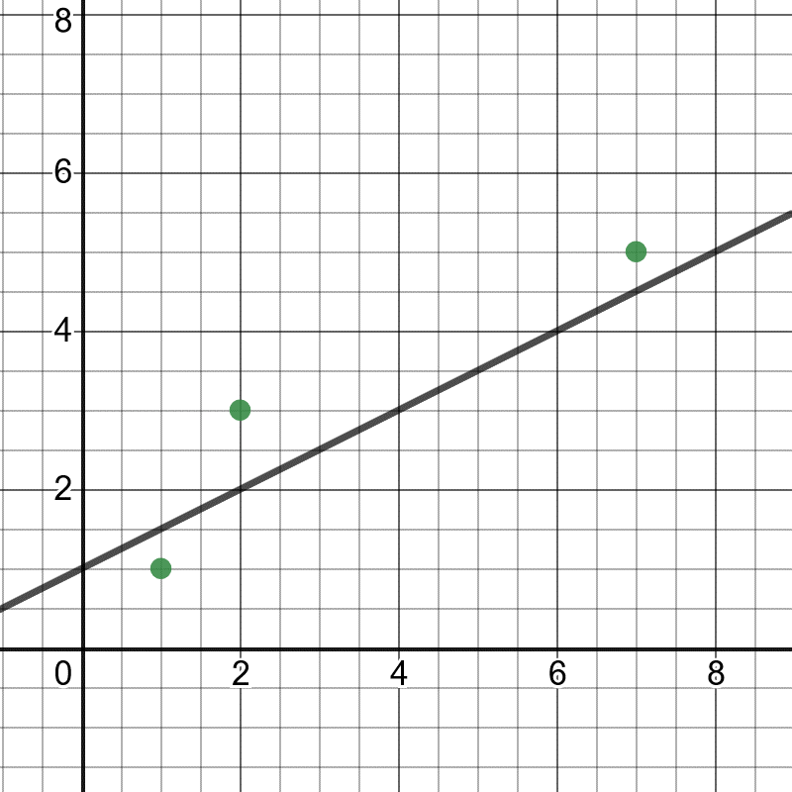
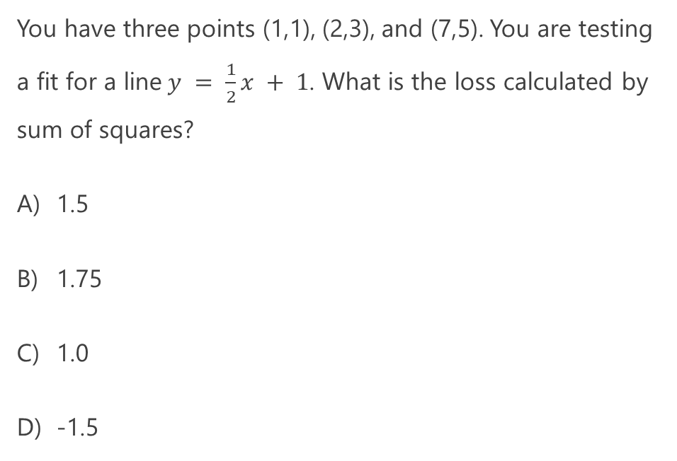
Quiz Time!
You have three points (1,1), (2,3), and (7,5). You are testing a fit for a line$y = \frac{1}{2}x + 1$. What is the loss calculated by sum of squares?
1.5
1.75
1.0
-1.5

Slide 33
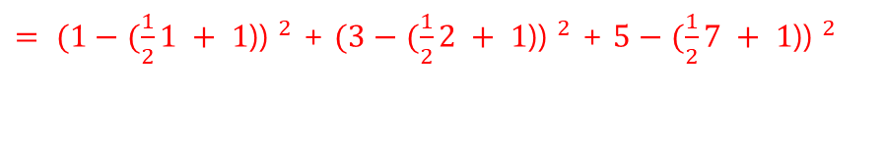
Quiz Time!
You have three points (1,1), (2,3), and (7,5). You are testing a fit for a line$y = \frac{1}{2}x + 1$. What is the loss calculated by sum of squares?
1.5
1.75
1.0
-1.5
${= (1−(\frac{1}{2}1 + 1\text{)) }}^{2}$ + ${(3−(\frac{1}{2}2 + 1\text{)) }}^{2}$ + ${5−(\frac{1}{2}7 + 1\text{)) }}^{2}$

Slide 34
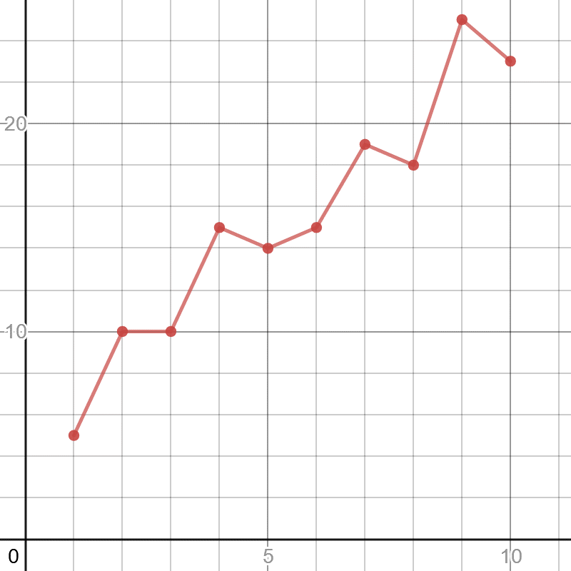
Quiz Time!
It is good to fit a regression as close to the points as possible, even if you just connect the points as shown to the right.
True
False

Slide 35

Quiz Time!
It is good to fit a regression as close to the points as possible, even if you just connect the points as shown to the right.
True
False
Doing a regression is a balancing act between fitting exactly to your data (variance) versus leaving some wiggle room (bias) to predict new data that will be different. Otherwise you will risk overfitting even if you have zero loss.
You might be better doing a linear regression (blue line) as shown to the right, which has a loss but is more likely to predict new data accurately.

Slide 36
Section III Logistic Regression

Slide 37
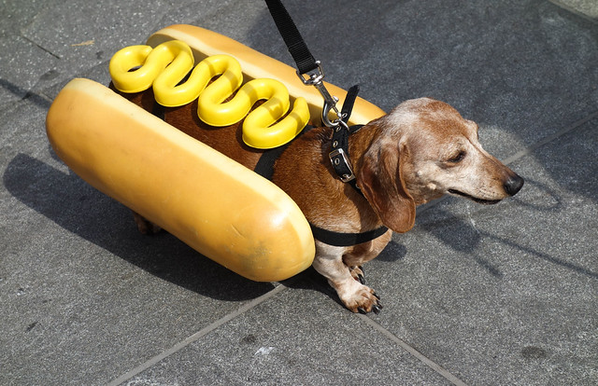
Classifying Things
So far we just did regressions via linear regression.
However, linear regressions are awkward to use for classification.
Lines extend in a straight direction for positive infinity and negative infinity, well outside a range of acceptable values.
Lines do not do a good job representing a probability and staying within the limits of 0.0 and 1.0.
When doing classification, probability is a critical tool.
Hot dog: 0.92

Slide 38
Classifying Things
Classification tasks are pretty common in machine learning:
How do I classify images of dogs versus cats?
Will a shipment be most likely be late, early, or on-time?
Is this email spam or not spam?
Will this movie get 1 star, 2 stars... or 5 stars?
There are several machine learning algorithms that work well for classification, and we are going to learn first about Logistic Regression.
Hot dog: 0.92

Slide 39
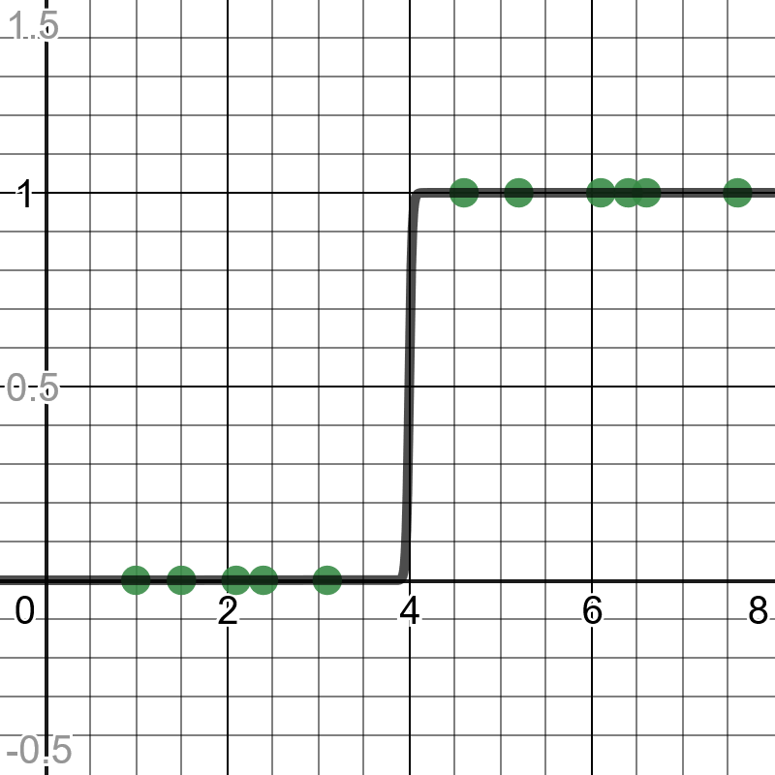
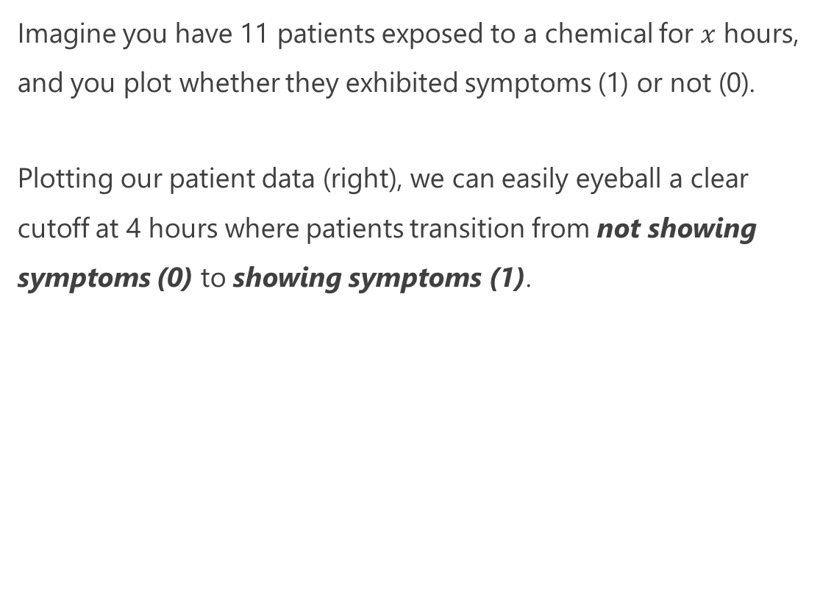
Logistic Regression Intuition
Imagine you have 11 patients exposed to a chemical for $x$ hours, and you plot whether they exhibited symptoms (1) or not (0).
Plotting our patient data (right), we can easily eyeball a clear cutoff at 4 hours where patients transition from not showing symptoms (0) to showing symptoms (1).
https://www.desmos.com/calculator/prs2p0sofc

Slide 40
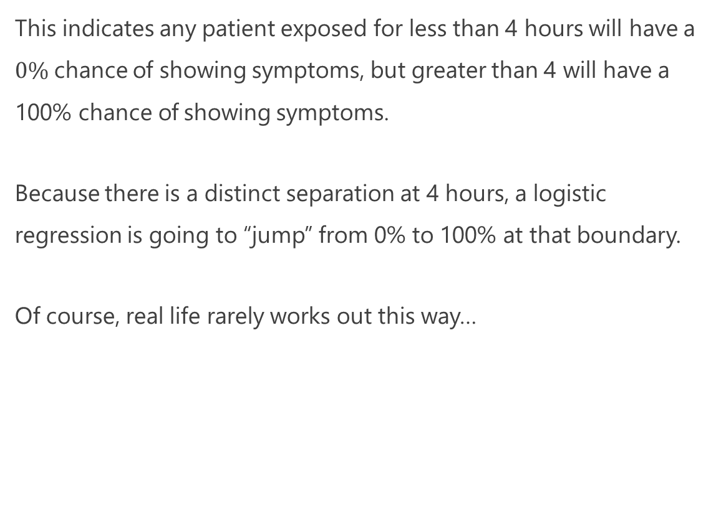
Logistic Regression Intuition
This indicates any patient exposed for less than 4 hours will have a $0\%$chance of showing symptoms, but greater than 4 will have a 100% chance of showing symptoms.
Because there is a distinct separation at 4 hours, a logistic regression is going to “jump” from 0% to 100% at that boundary.
Of course, real life rarely works out this way…
https://www.desmos.com/calculator/prs2p0sofc

Slide 41

Logistic Regression Intuition
Now let’s say you gathered more data and got a realistic picture, where the middle of the range has a mix of patients showing symptoms and not showing symptoms.
The way to interpret this is the probability of patients showing symptoms gradually increases with each hour of exposure.
Because of this overlap of points in the middle, there is no distinct cutoff when patients show symptoms, but rather a gradual transition from 0% probability to 100% probability (“0” and “1”).
https://www.desmos.com/calculator/bsqtqfians

Slide 42
Logistic Regression Intuition
More technically, a logistic regression results in a curve indicating a probability of belonging to the true (1) category, which in this case means a patient showed symptoms.
As the hours of chemical exposure increases, the number of patients showing symptoms increases, and thus the probability of showing symptoms increases.
https://www.desmos.com/calculator/bsqtqfians

Slide 43
Logistic Regression
Logistic Regression is a classification tool that predicts a true or false value for one or more variables.
Training data must have outcomes of 0 (false) or 1 (true), but the regression will output a probability value between 0 and 1.
An S-shaped curve (a logistic function) is fit to the points and then used to predict probability.
If a predicted value (the y-axis) is less than .5 it is typically categorized as false (0), and if the predicted value is greater than/equal to .5 it is typically categorized as true (1).
https://www.desmos.com/calculator/bsqtqfians

Slide 44
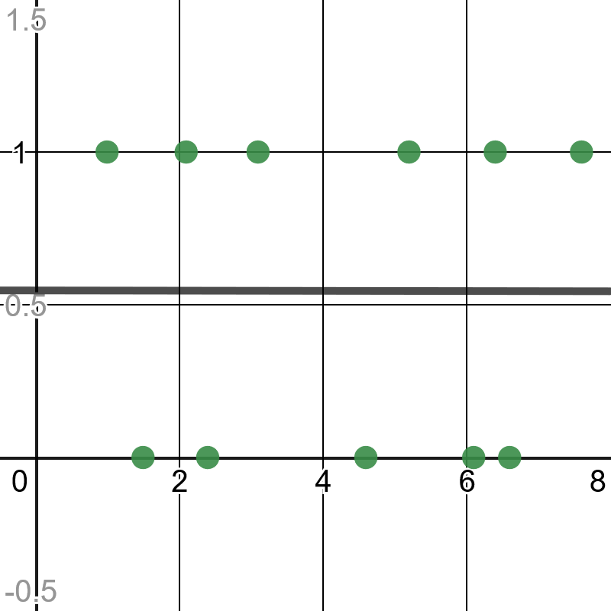
When Not To Use Logistic Regression
Of course, if there is no transitional trend in your data then you should not use logistic regression.
https://www.desmos.com/calculator/cmeksxk5rk

Slide 45
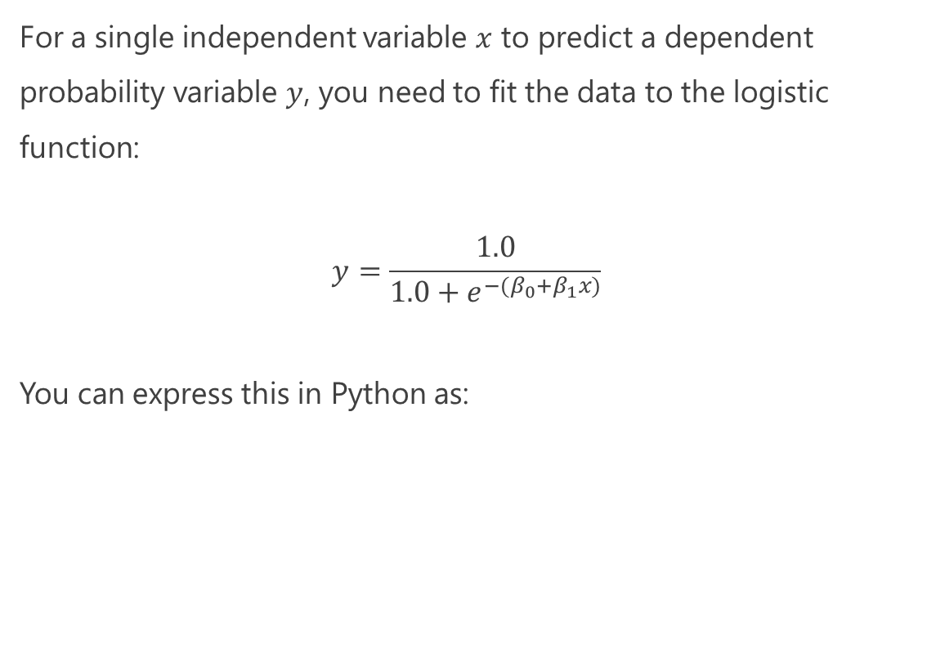
Just Show Me the Math!
For a single independent variable $x$ to predict a dependent probability variable $y$, you need to fit the data to the logistic function:
$$y=\frac{1.0}{1.0+e^{−{(β}_{0}+β_{1}x)}}$$
You can express this in Python as:
def predict_probability(x): p = 1.0 / (1.0 + math.exp(-(b0 + b1 * x))) return p
https://www.desmos.com/calculator/blfcwrlnuw

Slide 46
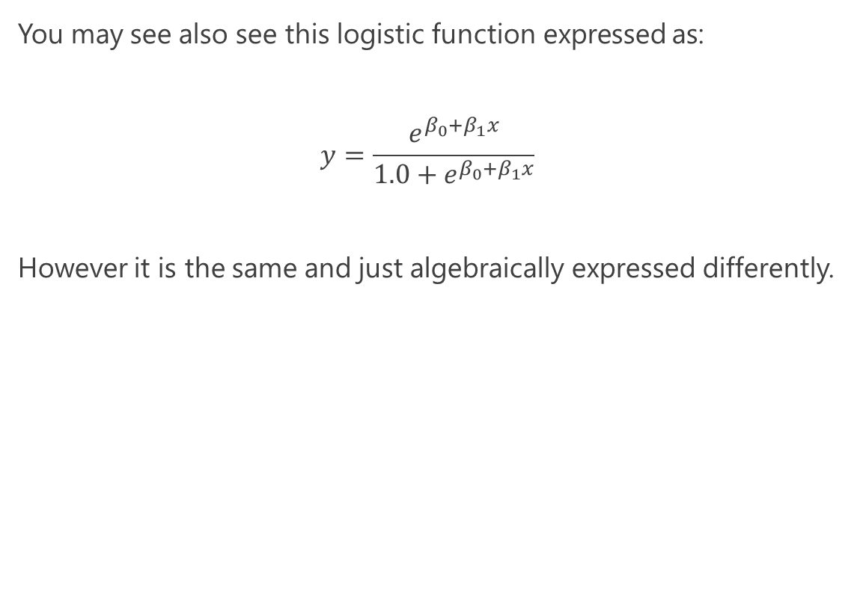
Just Show Me the Math!
You may see also see this logistic function expressed as:
$$y=\frac{e^{β_{0}+β_{1}x}}{1.0+e^{β_{0}+β_{1}x}}$$
However it is the same and just algebraically expressed differently.
https://www.desmos.com/calculator/blfcwrlnuw

Slide 47
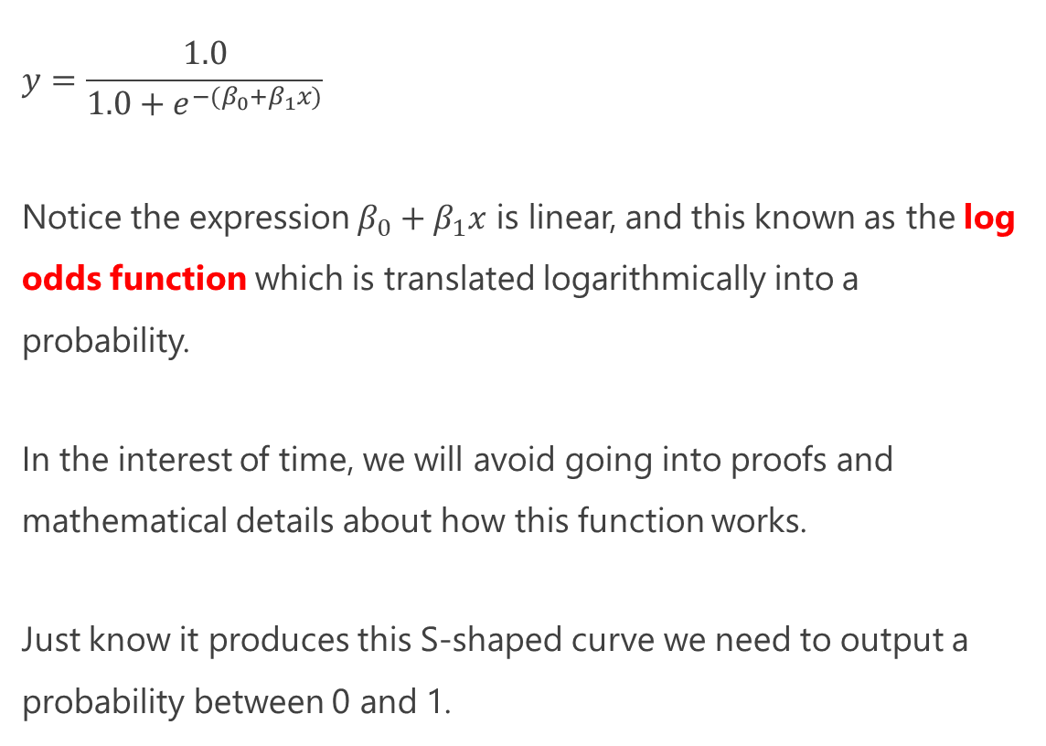
Just Show Me the Math!
$$y=\frac{1.0}{1.0+e^{−{(β}_{0}+β_{1}x)}}$$
Notice the expression $β_{0}+β_{1}x$ is linear, and this known as the log odds function which is translated logarithmically into a probability.
In the interest of time, we will avoid going into proofs and mathematical details about how this function works.
Just know it produces this S-shaped curve we need to output a probability between 0 and 1.
def predict_probability(x): p = 1.0 / (1.0 + math.exp(-(b0 + b1 * x))) return p
https://www.desmos.com/calculator/blfcwrlnuw

Slide 48
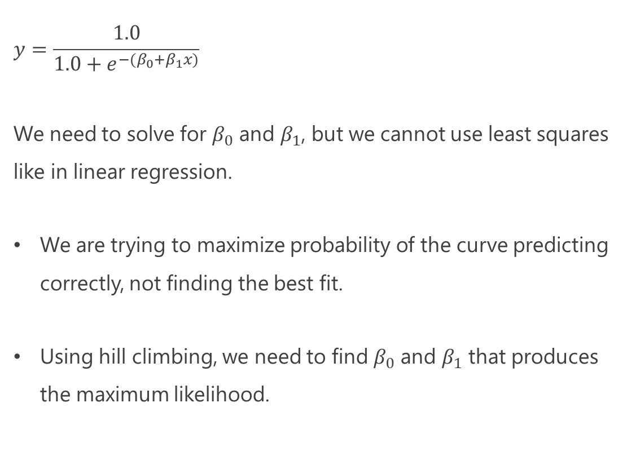
Just Show Me the Math!
$$y=\frac{1.0}{1.0+e^{−{(β}_{0}+β_{1}x)}}$$
We need to solve for $β_{0}$ and $β_{1}$, but we cannot use least squares like in linear regression.
We are trying to maximize probability of the curve predicting correctly, not finding the best fit.
Using hill climbing, we need to find $β_{0}$ and $β_{1}$ that produces the maximum likelihood.
def predict_probability(x): p = 1.0 / (1.0 + math.exp(-(b0 + b1 * x))) return p
https://www.desmos.com/calculator/blfcwrlnuw

Slide 49
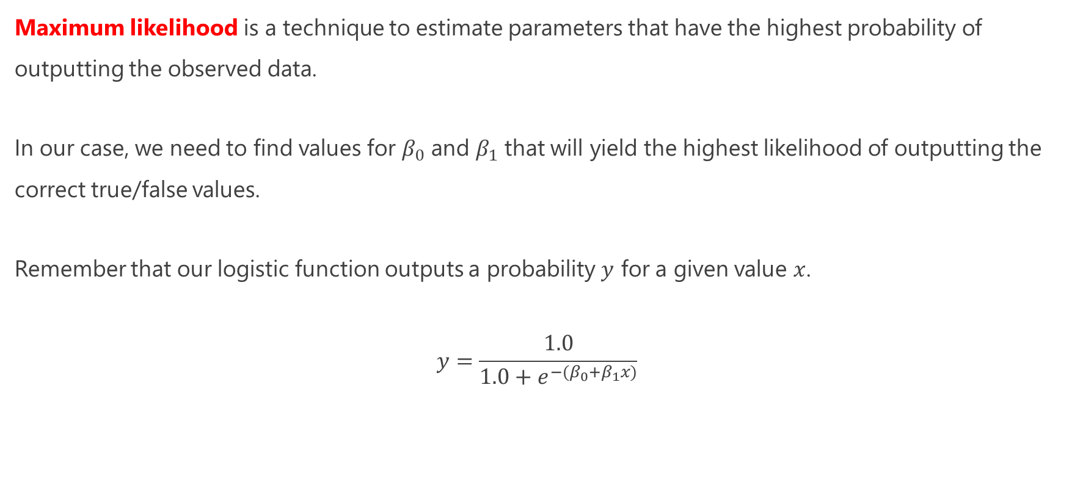
Maximum Likelihood
Maximum likelihood is a technique to estimate parameters that have the highest probability of outputting the observed data.
In our case, we need to find values for $β_{0}$ and $β_{1}$ that will yield the highest likelihood of outputting the correct true/false values.
Remember that our logistic function outputs a probability $y$ for a given value $x$.
$$y=\frac{1.0}{1.0+e^{−{(β}_{0}+β_{1}x)}}$$

Slide 50
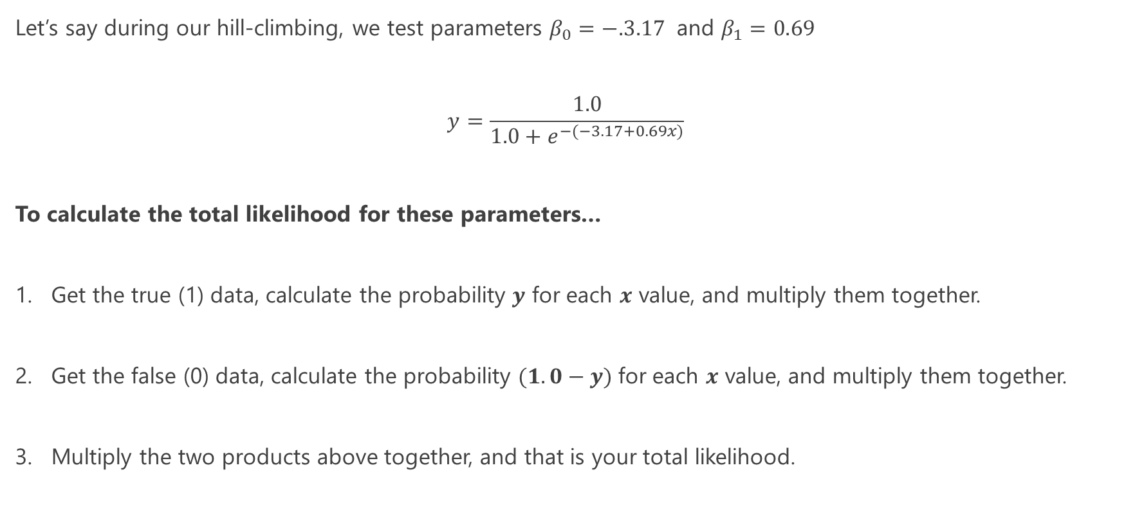
Maximum Likelihood
Let’s say during our hill-climbing, we test parameters $β_{0}=−.3.17$ and $β_{1}=0.69$
$$y=\frac{1.0}{1.0+e^{−(−3.17+0.69x)}}$$
To calculate the total likelihood for these parameters…
Get the true (1) data, calculate the probability $y$ for each $x$ value, and multiply them together.
Get the false (0) data, calculate the probability $(1.0−y)$for each $x$ value, and multiply them together.
Multiply the two products above together, and that is your total likelihood.

Slide 51
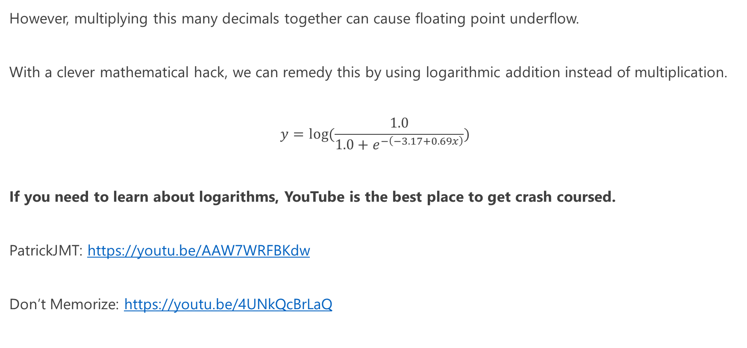
Maximum Likelihood – Avoiding Floating Point Underflow
However, multiplying this many decimals together can cause floating point underflow.
With a clever mathematical hack, we can remedy this by using logarithmic addition instead of multiplication.
$$y=log⁡(\frac{1.0}{1.0+e^{−\left(−3.17+0.69x\right)}})$$
If you need to learn about logarithms, YouTube is the best place to get crash coursed.
PatrickJMT: https://youtu.be/AAW7WRFBKdw
Don’t Memorize: https://youtu.be/4UNkQcBrLaQ

Slide 52
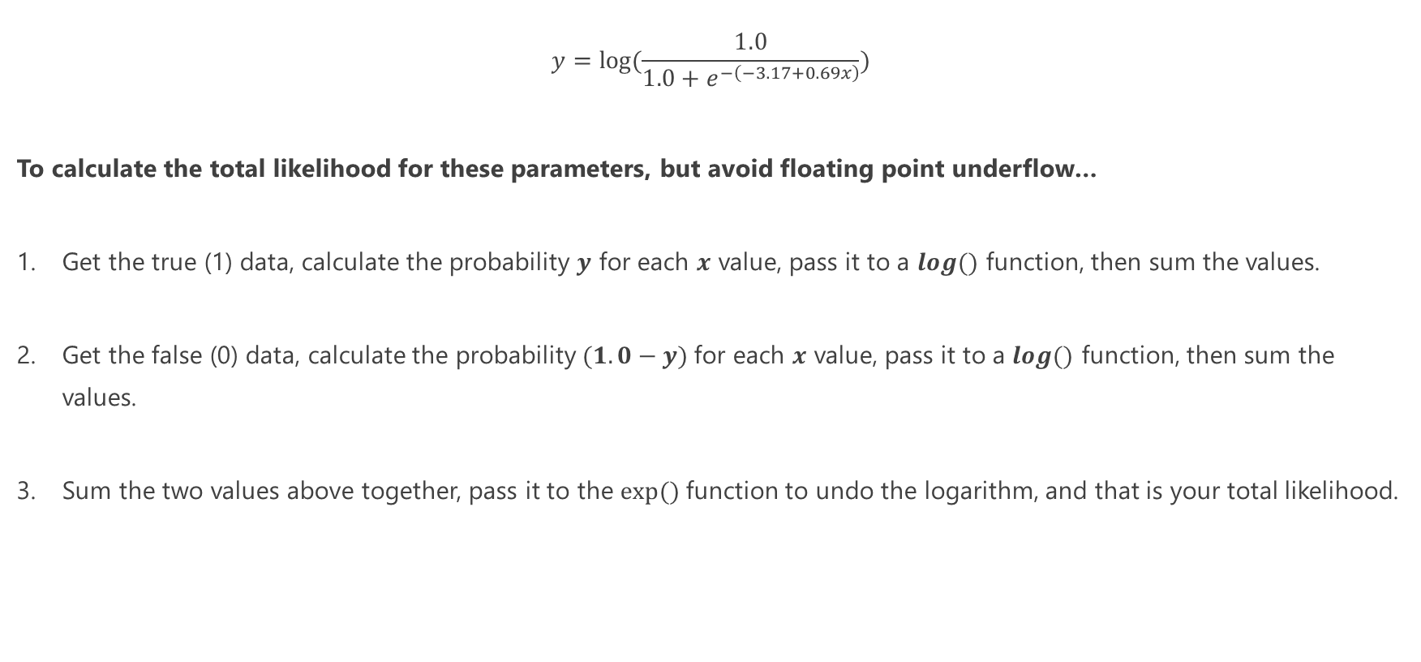
Maximum Likelihood – Avoiding Floating Point Underflow
$$y=log⁡(\frac{1.0}{1.0+e^{−\left(−3.17+0.69x\right)}})$$
To calculate the total likelihood for these parameters, but avoid floating point underflow…
Get the true (1) data, calculate the probability $y$ for each $x$ value, pass it to a $log⁡()$ function, then sum the values.
Get the false (0) data, calculate the probability $(1.0−y)$for each $x$ value, pass it to a $log⁡()$ function, then sum the values.
Sum the two values above together, pass it to the $exp⁡()$function to undo the logarithm, and that is your total likelihood.

Slide 53
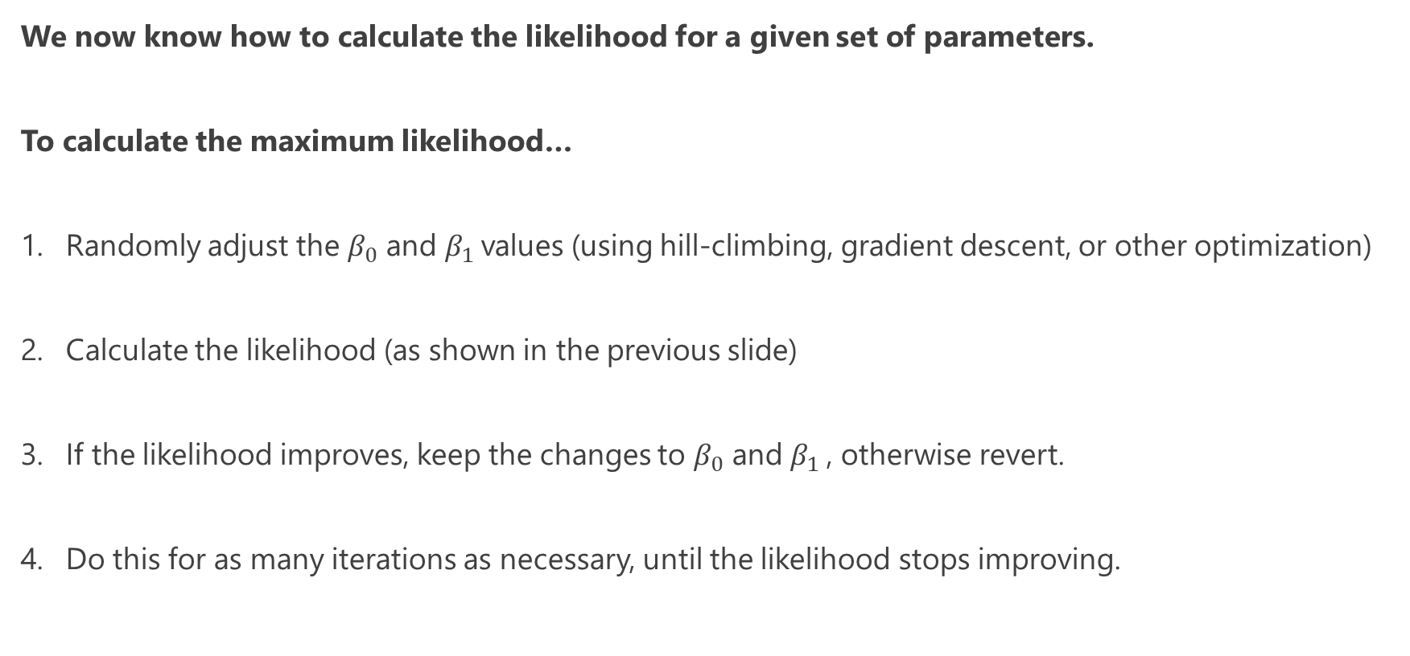
Maximum Likelihood
We now know how to calculate the likelihood for a given set of parameters.
To calculate the maximum likelihood…
Randomly adjust the $β_{0}$ and $β_{1}$values (using hill-climbing, gradient descent, or other optimization)
Calculate the likelihood (as shown in the previous slide)
If the likelihood improves, keep the changes to $β_{0}$ and $β_{1}$, otherwise revert.
Do this for as many iterations as necessary, until the likelihood stops improving.

Slide 54
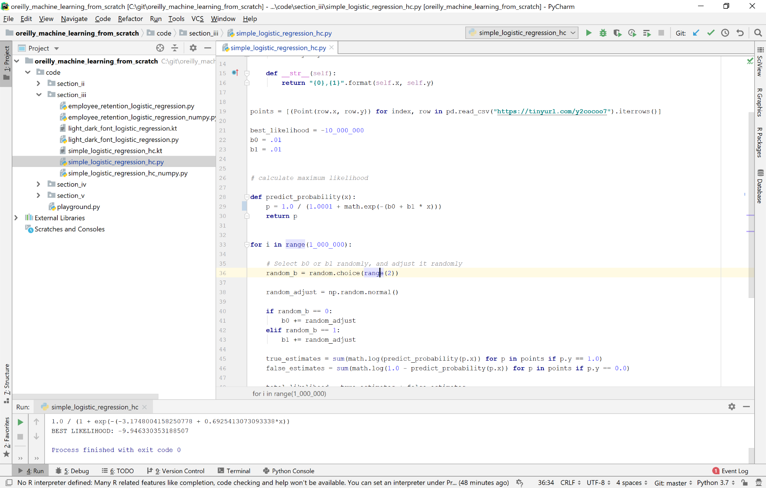
Hands-On: Logistic Regression

Slide 55
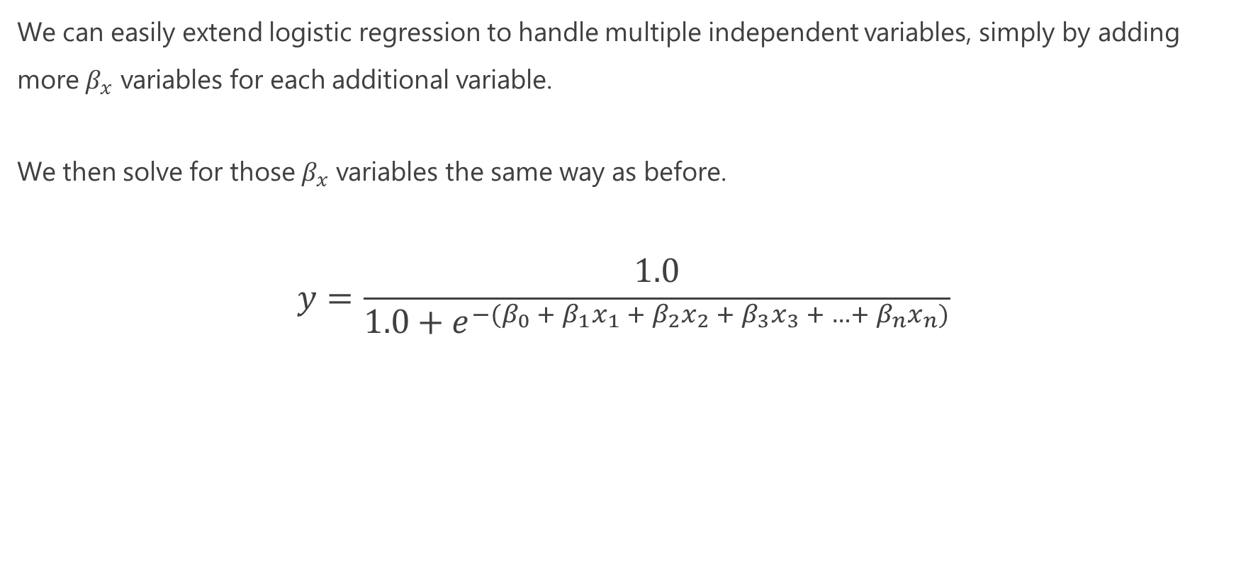
Multivariable Logistic Regression
We can easily extend logistic regression to handle multiple independent variables, simply by adding more $β_{x}$ variables for each additional variable.
We then solve for those $β_{x}$ variables the same way as before.
$$y=\frac{1.0}{1.0+e^{−{(β}_{0} + β_{1}x_{1} +{ β}_{2}x_{2} +{ β}_{3}x_{3} + …+{ β}_{n}x_{n})}}$$

Slide 56
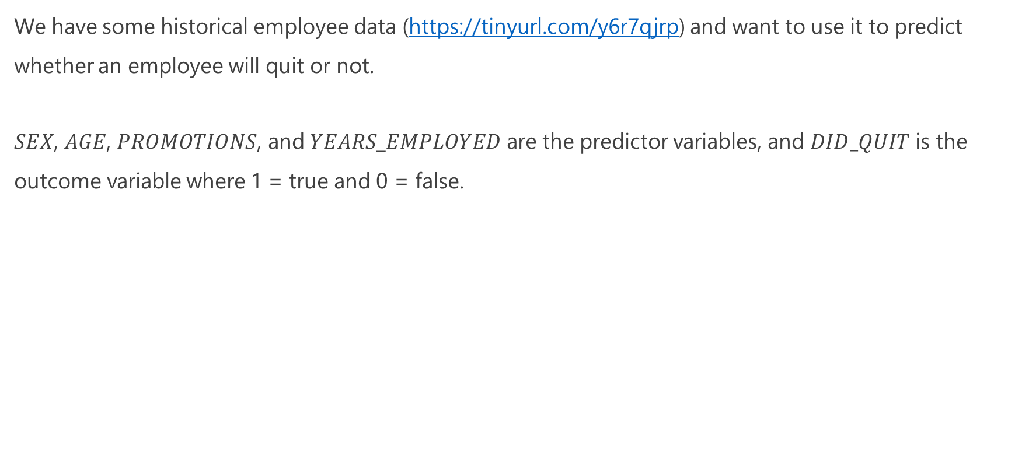
Multivariable Logistic Regression
We have some historical employee data (https://tinyurl.com/y6r7qjrp) and want to use it to predict whether an employee will quit or not.
$SEX$, $AGE$, $PROMOTIONS$, and $YEARS$_$EMPLOYED$ are the predictor variables, and $DID_QUIT$ is the outcome variable where 1 = true and 0 = false.

Slide 57
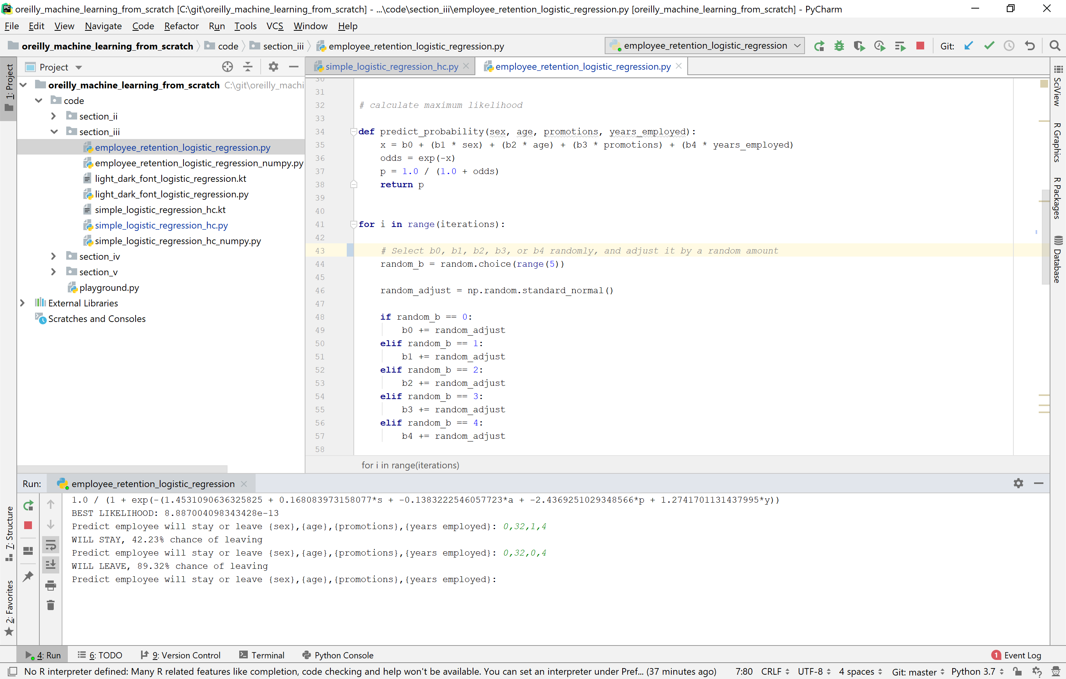
Hands-On: Multivariable Logistic Regression

Slide 58
Using Logistic Regression for Classification
Logistic regression may seem limited in that it only supports two categories: true (1) or false (0).
But you can make it support any number of categories!
To use logistic regression for more than two categories:
Build a separate logistic regression for each category, where a given item belongs to that category (1) or doesn’t belong to that category (0).
To predict which category an item belongs to, pass it through each category’s logistic regression, and choose the one with the highest probability.

Slide 59

Kind Of Similar – Fitting a Probability Distribution
import random, math observations = [1.0, 1.0, 1.0, 2.0, 2.0, 3.0, 4.0, 4.0, 5.0, 5.0, 5.0] def normal_pdf(x: float, mean: float, std_dev: float) -> float: return (1.0 / (2.0 * math.pi * std_dev ** 2) ** 0.5) * math.exp(-1.0 * ((x - mean) ** 2 / (2.0 * std_dev ** 2))) best_likelihood = 0.0 std_dev = 1.0 mean = 1.0 for i in range(100_000): adj = random.normalvariate(0, 1) selected_variable = random.randint(0, 1) if selected_variable == 0: mean += adj elif selected_variable == 1: std_dev += adj likelihood = math.exp(sum([math.log(.000000001 + normal_pdf(x, mean, std_dev)) for x in observations])) if likelihood > best_likelihood: best_likelihood = likelihood elif selected_variable == 0: mean -= adj elif selected_variable == 1: std_dev -= adj print("mean={0}, std_dev={1}".format(mean, std_dev))

Slide 60

Exercise: “There’s No Correlation”
It is one day from a manned space launch.
However, your engineering team has been expressing concern about the O-Rings that seal rocket gases from releasing, and whether they perform in colder temperatures.
You share this concern with other parties and are provided data of all 7 O-Ring failures from 24 launches and the temperature (shown to the right).
The consensus from other parties is there is no correlation between number of failures and temperature.
Is this assessment correct?
Data Source: http://www.math.usu.edu/~symanzik/teaching/2009_stat6560/RDataAndScripts/sharif_abbass_project1_challenger.csv

Slide 61
Exercise: “There’s No Correlation”
It is one day from a manned space launch.
However, your engineering team has been expressing concern about the O-Rings that seal rocket gases from releasing, and whether they perform in colder temperatures.
You share this concern with other parties and are provided data of all 7 O-Ring failures from 24 launches and the temperature (shown to the right).
The consensus from other parties is there is no correlation between number of failures and temperature.
Is this assessment correct? Is anything missing?
Data Source: http://www.math.usu.edu/~symanzik/teaching/2009_stat6560/RDataAndScripts/sharif_abbass_project1_challenger.csv

Slide 62

Exercise: “There’s No Correlation”
Notice that data from successful launches were not included, which may tell an entirely different story.
What are your thoughts now? Is there a correlation? Is there a model that can be used to predict risk?

Slide 63

Exercise: “There’s No Correlation”
You can try to apply a linear regression here, and while it does show a trend it is a little awkward especially since our data is sparse.
Should we transform our data somehow? Are there any other models we can try?

Slide 64
Linear Regression Source Code
import pandas as pd from sklearn.linear_model import LinearRegression # Learn more: https://scikit-learn.org/stable/modules/generated/sklearn.linear_model.LinearRegression.html # Import points df = pd.read_csv('https://bit.ly/2DgjTk5', delimiter=",") # Extract input variables (all rows, all columns but last column) X = df.values[:, :-1] # Extract output column (all rows, last column) Y = df.values[:, -1] # Plain ordinary least squares fit = LinearRegression().fit(X, Y) # Print "m" and "b" coefficients print("m = {0}".format(fit.coef_.flatten())) print("b = {0}".format(fit.intercept_.flatten()))

Slide 65

Exercise: “There’s No Correlation”
What if we converted the data to be binary, showing whether a failure occurred or not occurred, by separating each instance into its own record?
This reduces the domain of output variables to “0” and “1” creating a binary model.
Is a story now becoming clear? What model can we use to predict probability of failure at a given temperature?

Slide 66

Exercise: “There’s No Correlation”
Logistic regression might be the best way to model this risk.
Even though we lack freezing temperature data, the logistic regression points to a high probability of risk for O-ring failure.
If our launch is going to happen in freezing temperatures, this does not bode well.

Slide 67


Exercise: “There’s No Correlation”
This is exactly what happened to the space shuttle Challenger on January 28, 1986, and if you already have not figured out already, we are doing the analysis.
Through a series of unfortunate events, only partial data was accessible and omitted non-failure data, which showed a correlation with temperature and O-ring failure.
The analysis we just did should have happened before the accident, but unfortunately it occurred afterwards.
We will learn later about how biases, class imbalance, and broken data can derail machine learning and statistical models.
The space shuttle Challenger just moments before disaster on January 28, 1986 (above) and Richard Feynman famously demonstrating O-ring failure with a glass of ice water (left).

Slide 68
Space Shuttle Challenger: Logistic Regression Source Code
import numpy as np import pandas as pd import plotly.graph_objects as go from sklearn.linear_model import LogisticRegression # Load the data df = pd.read_csv("https://bit.ly/2DgjTk5", delimiter=",") # Duplicate and convert records to have binary outcomes df = df.loc[df.index.repeat(df["o_ring_failures"])].append(df[df["o_ring_failures"] == 0]) df.loc[(df["o_ring_failures"] > 0), 'o_ring_failures'] = 1 # Extract input variables (all rows, all columns but last column) X = df.values[:, :-1] # Extract output column (all rows, last column)\ Y = df.values[:, -1] model = LogisticRegression() model.fit(X, Y) # Print "m" and "b" coefficients print("m = {0}".format(model.coef_.flatten())) print("b = {0}".format(model.intercept_.flatten())) # Plot results fig = go.Figure() fig.add_trace(go.Scatter(x=df["temperature"], y = df["o_ring_failures"], mode='markers', name="Observations")) fig.add_trace(go.Scatter(x=np.arange(0.0,90.0,.1), y= model.predict_proba(np.arange(0.0,90.0,.1).reshape(-1, 1))[:,-1], mode='lines', name='Logistic Regression')) fig.show()

Slide 69
Quiz Time!
Logistic regression will only output a probability between 0 and 1 that an event will happen.
True
False

Slide 70
Quiz Time!
Logistic regression will only output a probability between 0 and 1 that an event will happen.
True
False
Like any probability model, logistic regression will output a percentage between 0 and 1

Slide 71
Quiz Time!
Logistic regression cannot be used for more than two categories.
True
False

Slide 72
Quiz Time!
Logistic regression cannot be used for more than two categories.
True
False
Logistic regression can support more than one category by doing a separate logistic regression for each category, and predicting the one that yields the highest probability.

Slide 73
Section IV Naïve Bayes

Slide 74

What is Naïve Bayes?
Naïve Bayes is a machine learning application of Bayes Theorem that merges probabilities of multiple features to predict a given category.
It is often used to classify text (e.g. email spam/not spam), which is the exercise the we will be doing today.
Naïve Bayes is effective because it learns quickly, even with little data.
Naive Bayes works by mapping probabilities of each individual feature occurring/not occurring for a given category (e.g. a word occurring in spam/not spam).
While commonly used for discrete variables like words, it can also be used with continuous variables using statistical distributions (we will not cover this today).
Thomas Bayes, the inventor of Bayes Theorem

Slide 75

Demo: Categorizing Bank Transactions

Slide 76


How to Build a Naïve Bayes Text Classifier
To predict a category for a new set of features:
For a given category (like spam, grocery, etc), combine the probabilities of each feature occurring and not occurring by multiplying them.
$Occur Product=P_{f1}∗P_{f2}∗$ $P_{f3} ∗{…∗ P}_{fn}$
$$Not Occur Product={(1 −P}_{f1})∗{(1 −P}_{f2})∗{(1 −P}_{f3}){∗ …∗(1 −P}_{fn})$$
Combine the probabilities above with this division operation:
$$Combined Probability = \frac{(Occur Product)}{\left(Occur Product\right)+(Not Occur Product)}$$

Slide 77
How to Build a Naïve Bayes Text Classifier
3) Calculate the combined probability for every category, and the one that is the highest is the category you predict.
Easy right? But there is one complication…

Slide 78


Dealing with Floating Point Underflow
Remember in logistic regression where we had floating point underflow issues, where multiplying small decimals gets so small the computer cannot handle them?
We can remedy the issue here too by using logarithmic addition rather than multiplication.
Transform each probability with a $log⁡()$or $ln⁡()$function and then sum them, then call $exp⁡()$ to convert the result back!

Slide 79

Dealing with Floating Point Underflow
$$P_{fx}=Probability of feature \text{x}$$
$Occur Product={exp⁡(log⁡(P}_{f1})+{log⁡(P}_{f2})+$ log($P_{f3}){+ log⁡(P}_{fn}))$
$$Not Occur Product={exp(log(1 −P}_{f1})+log{(1 −P}_{f2})+log{(1 −P}_{f3}){+ …+log(1 −P}_{fn}))$$
$$Combined Probability = \frac{(Occur Product)}{\left(Occur Product\right)+(Not Occur Product)}$$

Slide 80

One More Thing…
Never let a feature have a zero probability, so add some small constants to the numerator and denominator like 0.1 and 0.2 to make a default probability.
“Fudging” the numbers in machine learning can be acceptable since machine learning deals with estimates anyway.
You can make these numbers smaller if you like.
$$Feature Probability = \frac{0.1+(Occur Probability)}{0.2+ \left(Occur Probability\right)+(Not Occur Probability)}$$

Slide 81

Final Naïve Bayes Formulation
$P_{fx}=Probability of feature \text{x}$, with a fudged constant in numerator and denominator
$Occur Product={exp⁡(log⁡(P}_{f1})+{log⁡(P}_{f2})+$ log($P_{f3}){+ log⁡(P}_{fn}))$
$$Not Occur Product={exp(log(1 −P}_{f1})+log{(1 −P}_{f2})+log{(1 −P}_{f3}){+ …+log(1 −P}_{fn}))$$
$$Combined Probability = \frac{(Occur Product)}{ \left(Occur Product\right)+(Not Occur Product)}$$

Slide 82



Learn More about Bayesian Modeling
Brandon Rohrer - YouTube

Slide 83
Section V Decision Trees and Random Forests

Slide 84

What Are Decision Trees?
Decision trees are a powerful machine learning tool and work well for a lot of machine learning problems.
As a matter of fact, decisions trees work so well they are notorious for overfitting.
This can be remedied with random forests which generates hundreds of decision trees with randomly sampled data.
Decision trees can also be improved with gradient boosting and other techniques.
Other flavors of decision trees exist, like regression trees.

Slide 85

Decision Tree Intuition
We have some weather data and labeled each record as being “1” (good weather) or “0” (bad weather).
We could solve this using a logistic regression but let us try using decision trees instead.

Slide 86

Decision Tree Intuition
Start with the variable that is most likely to separate good weather and bad weather as best as possible.
For reasons we will discuss later, you determine RAIN is good at separating good weather and bad weather, so you bucket records like this:

Slide 87

Decision Tree Intuition
Since all records where RAIN was present always yielded bad weather, we will simply predict any new record with RAIN as bad weather.
However, records that did not have RAIN are mixed, where some are good weather, and others are bad weather. These will need to be split again.

Slide 88

Decision Tree Intuition
We take records that did not have RAIN and now split them on TEMPERATURE.
Since TEMPERATURE is continuous and not a simple yes/no binary, we split on a value 78.5 that optimizes the split (more on this later).

Slide 89

Decision Tree Intuition
Notice how all records with TEMPERATURE greater than/equal to 78.5 are bad weather, so we will predict any records with a TEMPERATURE at least 78.5 as bad weather.
But records with a TEMPERATURE less than 78.5 have a mix of good weather and bad weather. So we need to split those again.

Slide 90

Decision Tree Intuition
We take those records with TEMPERATURE less than 78.5 and now split them on whether LIGHTNING was present.

Slide 91

Decision Tree Intuition
We take those records with TEMPERATURE less than 78.5 and now split them on whether LIGHTNING was present.
Notice how all records with LIGHTNING are labelled as bad weather, so we can predict any new record with LIGHTNING as bad weather.

Slide 92
Decision Tree Intuition
We take those records with TEMPERATURE less than 78.5 and now split them on whether LIGHTNING was present.
Notice how all records with LIGHTNING are labelled as bad weather, so we can predict any new record with LIGHTNING as bad weather.
Notice how close we are to a perfect clean split now!

Slide 93
Decision Tree Intuition
LIGHTNING almost gave us a perfect split, where lightning being present would predict bad weather and no lightning almost always meant good weather.

Slide 94

Decision Tree Intuition
LIGHTNING almost gave us a perfect split, where lightning being present would predict bad weather and no lightning almost always meant good weather.
We could probably stop here, but let’s split these remaining records with no lightning. Finally we split on whether it was CLOUDY or not.

Slide 95

Decision Tree Intuition
At this point, we establish we cannot separate productively anymore and CLOUDY does not have any impact to our prediction.
It will always be good weather, given we already established there was no LIGHTNING, the TEMPERATURE is less than 78.5, and there is no RAIN.
Congratulations! We just built our first decision tree. But you might have a few questions…

Slide 96
Decision Trees – Getting to the “Decision” Part
Hopefully by now, you have a strong intuition on what decision trees are trying to accomplish.
However, you may have some lingering questions on HOW to build a decision tree.
At a given step, how do I determine which property is the best to split on?
Where do I split continuous variables like TEMPERATURE?
When do I stop splitting and end my decision tree?

Slide 97

Gini Impurity
To build a decision tree, we must discuss the concept of impurity which describes how mixed something is.
EXAMPLE: If we have 6 dogs and 3 cats in a kennel, we do not purely have dogs or cats.
Gini Impurity is a common way to measure impurity using this function (for events A and B):
$$1 −{\left(Probability of A\right)}^{2}− {\left(Probability of B\right)}^{2}$$
So the Gini impurity of dogs versus cats in the kennel:
$$1 −{\left(\frac{6}{6+3}\right)}^{2}− {\left(\frac{3}{6+3}\right)}^{2}= .44444$$

Slide 98

Gini Impurity – Plotting for the Curious
The Gini impurity can never exceed 0.5, and this makes sense because having something 100% mixed (1.0) doesn’t make sense.
To the right we use SymPy to plot the gini impurity function.
from sympy import * a = symbols('a') b = 1.0 - a gini_impurity_f = 1 - a**2 - b**2 plot(gini_impurity_f, (a, 0, 1))

Slide 99

Gini Impurity
Going back to the weather example, here’s how we look at Gini impurity for RAIN.
Notice how the impurity for “good/bad weather” on the YES side is 0% meaning it is pure.
$$1 −{\left(\frac{0}{0+16}\right)}^{2}− {\left(\frac{16}{0+16}\right)}^{2}= 0$$

Slide 100

Gini Impurity
Going back to the weather example, here’s how we look at Gini impurity for RAIN.
Notice how the impurity for “good/bad weather” on the YES side is 0% meaning it is pure.
$$1 −{\left(\frac{0}{0+16}\right)}^{2}− {\left(\frac{16}{0+16}\right)}^{2}= 0$$
On the NO side we got an impurity of 48.4429%
$$1 −{\left(\frac{14}{14+20}\right)}^{2}− {\left(\frac{20}{14+20}\right)}^{2}= .484429$$

Slide 101

Weighing Gini Impurities
To calculate the entire impurity of using the RAIN property for a split, we weight these two impurities together.
$0 \frac{0+16}{0+16+14+20}+0.484429\frac{14+20}{0+16+14+20}= .32941172$
This is known as the weighted average Gini impurity, and it can be used as a measure of quality for splitting with that property. Lowest impurity is best!
At every step we choose the property that provides the least weighted average Gini impurity.

Slide 102

Building a Decision Tree with GINI
At each decision, we choose the next property with the best GINI impurity and split on it
EXAMPLE: After RAIN, the property TEMPERATURE has the next best GINI for those 34 items on the “NO” side.
When the next property’s weighted GINI is inferior to the previous GINI, we stop the branch there.

Slide 103

How to Split Continuous Variables?
Once you got the GINI and weighted GINI down, implementing a decision tree becomes relatively simple.
The goal always is to do a split that reduces the GINI impurity until it cannot be reduced anymore.
The only remaining question is how to split on continuous variables, which is not as straightforward as binary (true/false) or discrete (dog/cat/bird) variables.
Observe the following temperatures on the right. Any guesses on what is the best way to find the optimal split?

Slide 104
How to Split Continuous Variables?
Continuous variables extend the GINI concept further.
When you evaluate a continuous variable for its GINI, first sort the data for that variable then produce the rolling 2-value averages, each of which is a candidate for the split value.
Then choose the 2-value average that produces the best GINI impurity that splits on that value, which for the Temperature node we saw previously was 78.5.

Slide 105

Hands On: Decision Trees

Slide 106
Decision Trees and Overfitting
Decision trees work well, so much they are notorious for overfitting.
Overfitting again means the model fits to the training data too exactly, and therefore becomes unreliable for predicting new data.
One way to adapt decision trees to not overfit is to utilize random forests, which generates hundreds of decision trees with randomly sampled data and features.
This forces the model to use different subsets of data and properties, and therefore not overfit to the data set.

Slide 107

Random Forests
Random Forests are a machine learning technique that generates hundreds of decision trees, where each one builds off partial random data and properties, rather than all the data.
Typically each decision tree will train with only 2/3 of the randomly sampled data, which is known as bootstrapping.
You should also only consider a subset of variables when evaluating each node, forcing your decision tree to utilize other variables.
You can use the other 1/3 of the data (known as the “out-of-bag” data) as the test data to evaluate prediction performance.
With these hundreds of decision trees built, you then have each tree “vote” on a prediction. The prediction with the highest votes wins.

Slide 108

Fine-Tuning Random Forests
Because each decision tree in a random forest uses only 2/3 of the data for training, you can use the other 1/3 as test data.
You can choose the number of variables that yields the best accuracy on that test data.
For this exercise, I’m just going to randomly sample 2-3 properties for each node and call it a day.

Slide 109

Hands-On: Random Forests

Slide 110

Going Forward
Decision trees and random forests are a powerful and flexible tool in machine learning, and together work quite well for a lot of problems.
Decision trees can also be adapted to do regression with regression trees and enhanced with techniques like gradient boosting.
If I were to take one machine learning algorithm with me, it would be decision trees and all of its variants.
This Photo by Unknown Author is licensed under CC BY

Slide 111
Quiz Time!
Decision trees are effective because they do not overfit.
True
False

Slide 112
Quiz Time!
Decision trees are effective because they do not overfit.
True
False
Decision trees are so effective at fitting to data that they often overfit. Random forests and other techniques can be used to prevent overfitting

Slide 113

Quiz Time!
You have 100 patients. 44 have Celiac disease, 56 do not.
What is the GINI impurity of Celiac to non-Celiac patients?
A) .4928
B) .44
C) .56
D) .4720

Slide 114

Quiz Time!
You have 100 patients. 44 have Celiac disease, 56 do not.
What is the GINI impurity of Celiac to non-Celiac patients?
A) .4928
B) .44
C) .56
D) .4720
$$1 −{\left(\frac{44}{100}\right)}^{2}−{\left(\frac{56}{100}\right)}^{2}= .4928$$

Slide 115

Quiz Time!
You have 100 patients. 45 complained of stomach pain after drinking beer, the other 55 did not.
Of the 45 patients with stomach pain, 37 have Celiac disease.
Of the 55 patients without stomach pain, 7 have Celiac disease.
What is the weighted GINI impurity for using post-beer stomach pain to determine whether a patient has Celiac disease?
A) .50 B) .2537 C) .4506 D) .45

Slide 116

Quiz Time!
You have 100 patients. 45 complained of stomach pain after drinking beer, the other 55 did not.
Of the 45 patients with stomach pain, 37 have Celiac disease.
Of the 55 patients without stomach pain, 7 have Celiac disease.
What is the weighted GINI impurity for using post-beer stomach pain to determine whether a patient has Celiac disease?
A) .50 B) .2537 C) .4506 D) .45
($\frac{45}{100})\left(1 −{\left(\frac{37}{45}\right)}^{2}−{\left(\frac{8}{45}\right)}^{2}\right)$+ ($\frac{55}{100})\left(1 −{\left(\frac{7}{55}\right)}^{2}−{\left(\frac{48}{55}\right)}^{2}\right)= .2537$

Slide 117
Section VI Neural Networks

Slide 118

What Are Neural Networks?
Neural networks are multi-layered regressions that accept numeric inputs and produce numeric outputs, through a series of “middle layers” of multiplication and addition.
A series of weights are multiplied and added against one input layer which feeds into another.
Practical applications of neural networks include recognition and generation of image, audio, video, and language.
Neural networks are utilized to employ deep learning, which utilizes middle layers hence the name “deep”.

Slide 119

Neural Networks - Theoretical versus Practical Applications
Neural networks have usefulness in certain domains, but it is important to discern theoretical versus practical capabilities.
Theoretical capabilities range from interesting research ideas to sensational science fiction, like artificial general intelligence.
Practical capabilities are often narrow tasks like image/audio/video/language recognition and generation.
Discerning the above will help prevent confusion and not chase red herrings caused by hype.
Neural networks are loosely inspired by biological brains but are by no means a replication of them, so keep that in mind when managing expectations.
A typical stock photo for AI articles and media, which often contain anthropomorphized androids and other science fiction imagery.

Slide 120
The Problem
Suppose we wanted to take a background color (in RGB values) and predict a light/dark font for it.
Hello
Hello
If you search around Stack Overflow, there is a nice formula to do this:
If you are unsure of the underlying model, you could solve this with logistic regression or decisions trees.
But let’s use a neural network.

Slide 121
A Simple Neural Network
Let’s represent background color as 3 numeric RGB inputs, and predict whether a DARK/LIGHT font should be used.
255
0
Hello
204
Mystery Math
1
Hello
204

Slide 122
A Simple Neural Network
255w₁+
204w₂+
204w₃
255
W₁
W₄
W
W
10
Multiply and sum again
2
Hello
W₃
255w₄+
204w₅+
204w₆
^{W}11
204
W₅
W
W
^{W}14
12
13
Multiply and sum again
Hello
W_{6 W}
7
W
8
255w +
W
7
204w₈+
204w₉
^{W}15
204
9

Slide 123
A Simple Neural Network
This is the “mystery math”
255w₁+
204w₂+
204w₃
255
W₁
W₄
W
W
10
Multiply and sum again
2
Hello
W₃
255w₄+
204w₅+
204w₆
^{W}11
204
W₅
W
W
^{W}14
12
13
Multiply and sum again
Hello
W_{6 W}
7
W
8
255w +
W
7
204w₈+
204w₉
^{W}15
204
9

Slide 124
A Simple Neural Network
Each weight w_{x} value is between -1.0 and 1.0
255w₁+
204w₂+
204w₃
255
W₁
W₄
W
W
10
Multiply and sum again
2
Hello
W₃
255w₄+
204w₅+
204w₆
^{W}11
204
W₅
W
W
^{W}14
12
13
Multiply and sum again
Hello
W_{6 W}
7
W
8
255w +
W
7
204w₈+
204w₉
^{W}15
204
9

Slide 125
A Simple Neural Network
Note we should also add a b_{x} bias value (between 0 and 1) to each node.
b₁+255w₁+
204w₂+
204w₃
255
W₁
W₄
W
W
10
Multiply and sum again
2
Hello
W₃
b₂+ 255w₄+
204w₅+
204w₆
^{W}11
204
W₅
W
W
^{W}14
12
13
Multiply and sum again
Hello
W_{6 W}
7
W
8
b₃+2557+
204w₈+
204w₉
W
^{W}15
204
9

Slide 126
A Simple Neural Network
Million Dollar Question:
What are the optimal weight (and bias) values to get the desired output?
b₁+255w₁+
204w₂+
204w₃
255
W₁
W₄
W
W
10
2
1.0
Hello
W₃
b₂+ 255w₄+
204w₅+
204w₆
^{W}11
204
W₅
W₇
W
^{W}14
12
13
W
0.0
Hello
W_{6 W}
7
8
b₃+2557+
204w₈+
204w₉
W
^{W}15
204
9

Slide 127
A Simple Neural Network
Answer:
Like most machine learning, this is an optimization problem!
b₁+255w₁+
204w₂+
204w₃
255
W₁
W₄
W
W
10
2
.998
Hello
W₃
b₂+ 255w₄+
204w₅+
204w₆
^{W}11
204
W₅
W₇
W
^{W}14
12
13
W
.01
Hello
W_{6 W}
8
b₃+2557+
204w₈+
204w₉
W
^{W}15
204
9

Slide 128
A Simple Neural Network
We need to solve for the weight (and bias) values that gets our training colors as close to their desired outputs as possible using hill climbing, simulated annealing, gradient descent, or other optimization methodologies.
b₁+255w₁+
204w₂+
204w₃
255
W₁
W₄
W
W
10
2
.998
Hello
W₃
b₂+ 255w₄+
204w₅+
204w₆
^{W}11
204
W₅
W₇
W
^{W}14
12
13
W
.01
Hello
W_{6 W}
7
8
b₃+2557+
204w₈+
204w₉
W
^{W}15
204
9

Slide 129
Activation Functions
RELU
TANH
SOFTMAX
You should also use activation functions on each layer.
These are nonlinear functions that smooth, scale, or compress
the resulting sum values.
Activation functions make the middle layers productive, separating features from each preceding layer.
Multiply and sum again
Multiply and sum again
Multiply and sum again
b₁+255w₁+
204w₂+
204w₃
255
b₂+ 255w₄+
204w₅+
204w₆
204
7
b₃+2557+
204w₈+
204w₉
204
https://towardsdatascience.com/activation-functions-neural-networks-1cbd9f8d91d6

Slide 130





Activation Functions
Four common neural network activation functions implemented in Python.
RELU
SIGMOID
TANH
SOFTMAX
https://www.desmos.com/calculator/jwjn5rwfy6

Slide 131

Building Neural Networks with NumPy
We avoided linear algebra up to this point because it can be distracting to understanding machine learning, but it does make neural networks easier to build.
On a practical level, linear algebra is about expressing numeric transformations with matrices.
Hopefully a matrix is a familiar concept where you express data as grids of numbers that can be multiplied, added, and transformed in various ways.
You can express a neural network with numeric training data and weights in matrix forms.

Slide 132


Resources to Learn Linear Algebra
3Blue1Brown - YouTube
O’Reilly – SciPy and NumPy
https://www.youtube.com/playlist?list=PLZHQObOWTQDPD3MizzM2xVFitgF8hE_ab

Slide 133




Building a Neural Network
First use NumPy to express your RGB input colors as a matrix. You will need to transpose the records, so each record is a column.
Since 255 is the maximum value for a color field, divide each value in the matrix by 255 to scale it between 0 and 1.
Input RGB Colors
Scaled Input RGB Colors
$$\begin{matrix}0 & 0 & 0 & 0 & 0 & 0 & 0 & … \\ 0 & 0 & 0 & 0 & 0 & 0 & 100 & … \\ 0 & 128 & 139 & 205 & 238 & 255 & 0 & …\end{matrix}$$
$$× \frac{1}{255} =$$
$$\begin{matrix}0 & 0 & 0 & 0 & 0 & 0 & 0 & … \\ 0 & 0 & 0 & 0 & 0 & 0 & .392 & … \\ 0 & .501 & .545 & .803 & .933 & 1 & 0 & …\end{matrix}$$

Slide 134






Building a Neural Network
3) Next create a 3 x 3 matrix of random values between 0 and 1, which will represent the weight values between the input and middle layer. Later we will randomly adjust these values with hill-climbing to get a desired output.
4) During each iteration while hill climbing, we will “multiply” these matrices using the dot product function, which will multiply each row of the first matrix to the column of the second matrix, then sum respectively (watch 3Blue1Brown on YouTube to learn more ).
Input→Middle Layer Weights
Scaled Input RGB Colors
First Output
$$\begin{matrix}.242 & .481 & .473 \\ .345 & .054 & .783 \\ .754 & .563 & .673\end{matrix}$$
$$×$$
$$\begin{matrix}0 & 0 & 0 & 0 & 0 & 0 & 0 & … \\ 0 & 0 & 0 & 0 & 0 & 0 & .392 & … \\ 0 & .501 & .545 & .803 & .933 & 1 & 0 & …\end{matrix}$$
$$=$$
$$\begin{matrix}0 & .237 & .257 & .380 & .441 & .473 & .188 & … \\ 0 & .393 & .426 & .629 & .730 & .730 & .021 & … \\ 0 & .337 & .366 & .541 & .628 & .628 & .220 & …\end{matrix}$$

Slide 135

Building a Neural Network
5) Declare the biases as a matrix with random values ranging from 0 to 1, and these will be added to the dot product output.
6) Apply the first layer’s activation function on our first layer output, which in this case we will use Relu which turns negative values into 0.
$relu\left(\left[\begin{matrix}0 & .237 & .257 & .380 & .441 & .473 & .188 & … \\ 0 & .393 & .426 & .629 & .730 & .730 & .021 & … \\ 0 & .337 & .366 & .541 & .628 & .628 & .220 & …\end{matrix}\right]+ \left[\begin{matrix}.23 \\ .61 \\ .33\end{matrix}\right]\right)=$ $\left[\begin{matrix}0 & .237 & .257 & .380 & .441 & .473 & .188 & … \\ 0 & .393 & .426 & .629 & .730 & .730 & .021 & … \\ 0 & .337 & .366 & .541 & .628 & .628 & .220 & …\end{matrix}\right]$

Slide 136
Alright, I’m going to save time
training_outputs = softmax(output_bias + output_weights.dot(relu(middle_bias + middle_weights.dot(training_inputs))))
7) Okay, I’m lazy and I want to get to the end result.
Here is what we are getting at. This is how you build the entire neural network with NumPy:
# Extract the input columns, scale down by 255
training_inputs = training_data.iloc[:, 0:3].values.transpose() / 255
# Build neural network with weights and biases
middle_weights = np.random.rand(3, 3)
output_weights = np.random.rand(2, 3)
middle_bias = np.random.rand(3, 1)
output_bias = np.random.rand(2, 1)
# Activation functions
def relu(x):
return np.maximum(x, 0)
def softmax(x):
return special.softmax(x, axis=0)
training_outputs = softmax(output_bias + output_weights.dot(relu(middle_bias + middle_weights.dot(training_inputs))))
The neural network!

Slide 137
Alright, I’m going to save time
training_outputs = softmax(output_bias + output_weights.dot(relu(middle_bias + middle_weights.dot(training_inputs))))
That beautiful, magical one line executes your input values, multiplies all the weights and adds all the biases for all three layers, applies each activation function, and outputs the recommendation matrix.
For millions of iterations, we will loop a hill-climbing algorithm randomly adjusting the weights to minimize loss.
If we are lucky, we will get a good weight configuration that predicts the right outputs for new colors.

Slide 138

Demo: Training a Neural Network

Slide 139
Loss Function
Weight/Bias Configurations

Slide 140
LOCAL MINIMUM
Loss Function
GLOBAL MINIMUM
Weight/Bias Configurations

Slide 141
Loss Function
Weight/Bias Configurations

Slide 142
Loss Function
Weight/Bias Configurations

Slide 143
Loss Function
Greedy algorithm gets stuck
Weight/Bias Configurations

Slide 144
Loss Function
We really want to be here
Weight/Bias Configurations

Slide 145
Loss Function
Or even here
Weight/Bias Configurations

Slide 146
How do we escape?
Loss Function
Weight/Bias Configurations

Slide 147
Make me slightly less greedy!
Loss Function
Weight/Bias Configurations

Slide 148
Occasionally allow a marginally inferior move...
Loss Function
Weight/Bias Configurations

Slide 149
Loss Function
To find superior solutions!
Weight/Bias Configurations

Slide 150
To find superior solutions!
Loss Function
Weight/Bias Configurations

Slide 151
When we have many local minima/maxima, it is because this problem is non-convex
Loss Function
Weight/Bias Configurations

Slide 152

Convex versus Non-Convex

Slide 153

Convex versus Non-Convex

Slide 154

The Hard Part of Deep Learning
A lot of the machine learning algorithms we have learned to this point were convex, meaning they have a single local minimum.
However, deep learning problems often have several local minima, and it can be challenging to end up in one that is optimal.
Like any machine learning algorithm, we also have to be careful to not overfit so finding the global minimum may not be a good thing!
In another O’Reilly Online Training Intro to Mathematical Optimization, we cover other techniques like simulated annealing and gradient descent to better address this problem.

Slide 155
Other Design Decisions
While optimizing weights is a core part of neural networks, there are other components to consider too:
How many middle layers are needed?
How many nodes are needed in each layer?
What activation functions should be applied to each layer?
Middle Layers - Should the layers be recurrent, recursive, convolutional, etc?
Loss function – How should we measure error?
Learning Rate - How aggressively should the optimization move towards the local minimum?

Slide 156
The Practicality of Neural Networks
Despite some seemingly intelligent applications like image recognition, neural networks have drawbacks:
Requires LOTS of labeled data for training.
Difficult for the data scientist to understand convoluted layers and nodes.
Has a quick diminishing return for problem spaces outside of image and natural language processing.
Neural networks generate excitement because many believe they will generalize solutions to most problems one day.
In reality, specialized and incumbent algorithms will outperform neural networks for most practical problems.

Slide 157



Problems with Deep Learning
Machine learning algorithms, especially deep learning, are not perfect and easily error-prone especially with outliers. Correlation is not Causation!
To the right are examples of a well-trained neural network unable to recognize images correctly due to objects in abnormal positions
SOURCE: https://arxiv.org/abs/1811.11553

Slide 158





Learn More About Neural Networks
3Blue1Brown - YouTube

Slide 159
Section VII Going Forward

Slide 160
Final Thoughts
Machine Learning is a powerful tool but is by no means a silver bullet or panacea.
“When all you have is a hammer, everything starts to look like a nail”
Data and data-driven models (like machine learning) are useful, but do not use them to solve problems that are better solved with more explicit models
Do not dismiss explicit models, business rules, and classical “AI” models like search algorithms to solve your problem too.
Be strategic about scaling your machine learning applications.
Learn NumPy so you can write more efficient Python machine learning programs, as this class does not teach how to code efficient models.
You can also learn faster programming platforms like C, C++, Go, Java, Kotlin, Scala, etc.

Slide 161




Great Books to Learn More About Machine Learning

Slide 162

Continuing Your Journey
If you enjoyed this online training, please take the sister class Intro to Mathematical Optimization.
Optimization is the heart of machine learning and the black box few explore.
There is far more to cover beyond hill climbing and optimization is intuitive, hard, and rewarding all at the same time.

Slide 163
Homework Assignments (Answers Are In “code” Folder)

Slide 164


Homework #1
You notice some data (accessible at https://bit.ly/2UBhrMG) has a familiar shape on a scatterplot, and you believe that the best regression will fit to a function
$$y=ax^{2}+b$$
where $a$ and $b$ are some constants. Find the $a$ and $b$ constants for the best fit regression based on sum of squares. I recommend using this Desmos Graph to graph your points and function to eyeball whether a good fit occurred.
HINT: Think of how you solved a linear regression using hill-climbing, and how it could apply here. Solution is in the folder code/homework_answers
https://www.desmos.com/calculator/canygmx67n

Slide 165
Homework #2
Take the RGB background color data (accessible at https://tinyurl.com/y2qmhfsr) that recommends a light (1) or dark (0) font. Create a logistic regression model that trains with that data and predicts a light/dark font for new background colors. Test to make sure a black background (0,0,0) will predict a LIGHT font and a white background (255,255,255) will predict a DARK font.
HINT: Remember the first three columns are the numeric inputs (red, green, blue) and the fourth column is the output (“1” for light, “0” for dark).
Solution is in the folder code/homework_answers

Slide 166
Homework #3
Take the employee retention data (accessible at https://tinyurl.com/y6r7qjrp) and make a decision tree to predict whether the employee will quit (1) or not quit (0).
As a quick and dirty test, check to see if employees who are not promoted for over two years generally quit by putting some in as inputs.
Solution is in the folder code/homework_answers
BONUS: Can you convert the model into a random forest with 600 decision trees?

Slide 167
Appendix A: Classification Validation

Slide 168

Training and Testing Data
A common practice to proactively prevent overfitting in machine learning is to separate training data and testing data.
Training data is data used to fit a model and is typically 2/3 of the data.
Test data is used to test the model and is the remaining 1/3 of the data.
By omitting the testing data from training, we see how well the model works on data it has not seen before and change our parameters accordingly.
DATA
TRAINING
TESTING

Slide 169

Cross-Validation
We can take this concept of training/testing data a step further, and test different combinations of training and testing data.
This is known as cross-validation, the gold standard of validation techniques.
To the right we have 3-fold cross validation which breaks the data into thirds and uses one of the pieces for testing.
We can then evaluate how well each of these perform, being able to compare different parameters and models (e.g. linear regression vs decision trees) and see which setup produces the best performance.
DATA
TRAINING
TRAINING
TESTING
TRAINING
TESTING
TRAINING
TESTING
TRAINING
TRAINING

Slide 170
Cross-Validation
We can take this concept of training/testing data a step further, and test different combinations of training and testing data.
This is known as cross-validation, the gold standard of validation techniques.
To the right we have 3-fold cross validation which breaks the data into thirds and uses one of the pieces for testing.
We can then evaluate how well each of these perform, being able to compare different parameters and models (e.g. linear regression vs decision trees) and see which setup produces the best performance.
DATA
TRAINING
TRAINING
TESTING
TRAINING
TESTING
TRAINING
TESTING
TRAINING
TRAINING

Slide 171
Cross-Validation
TRAINING
Note that k-fold cross validation allows us to slice our data into any number and not just 3 (typically 3, 5, or 10).
For example we can do 10-fold cross validation and validate 10 different combinations of training/test data.
The most extreme form of folding is leave-one-out cross validation, which omits one data record for testing and uses the remaining records for training, and this is done repeatedly.
TRAINING
TRAINING
TRAINING
TRAINING
TRAINING
TRAINING
TRAINING
TRAINING
TESTING

Slide 172
Random Fold Validation
As you may be noticing, machine learning often tries to overcome data variance with randomness.
A variant with fold validation is repeated random fold validation, where we randomly shuffle the data and create random train/test folds as many times as desired.
This is helpful when we need to mitigate variance in the model.
DATA

Slide 173
Which Validation to Use?
TRAINING
Generally, you will want to prefer k-fold validation as it is the gold standard.
A single train/test split might be warranted if performance of machine learning algorithm is slow and has enough data with lower bias.
Use the random fold split to mitigate variance in the model while balancing training speed and dataset sizes.
We will talk about class imbalance later, but if you do not have an equal number of samples for each class, you might want to consider using stratification in your k-fold validation.
Stratification means an equal proportion of data for each class is sampled for training and testing data (even it is sampled repeatedly), so that no class is neglected.
TESTING
TRAINING
TRAINING
TESTING
TRAINING
TESTING
TRAINING
TESTING
TRAINING
TRAINING

Slide 174
A Stratified Validation in Scikit-Learn
import numpy as np import pandas as pd # load data from sklearn.model_selection import train_test_split from sklearn.neural_network import MLPClassifier df = pd.read_csv(“https://tinyurl.com/y6r7qjrp”, delimiter=",") # Extract input variables (all rows, all columns but last column) # Note we should do some linear scaling here X = (df.values[:, :-1] / 255.0) + .01 # Extract output column (all rows, last column) Y = df.values[:, -1] # Get a count of each group to ensure samples are equitably balanced print(df.groupby(["class"]).agg({"class" : [np.size]})) # Separate training and testing data # Note that I use the 'stratify' parameter to ensure # each class is proportionally represented in both sets X_train, X_test, Y_train, Y_test = train_test_split(X, Y, test_size=.33, stratify=Y) nn = MLPClassifier(solver='sgd', hidden_layer_sizes=(100, ), max_iter=480, learning_rate_init=.1) nn.fit(X_train, Y_train) print("Training set score: %f" % nn.score(X_train, Y_train)) print("Test set score: %f" % nn.score(X_test, Y_test))

Slide 175
Validation Data
Validation is a separate type of testing data used to compare performance of different models.
When you are comparing two or more models (e.g. logistic regression versus decision trees), you may hold back one more chunk of data for validation.
It is different than the testing data, which is used to tune parameters of the individual model, not compare different models altogether.
DATA
TRAINING
TESTING
VALIDATION

Slide 176

Random Seeding
Machine learning deals with a lot of random-based operations:
Randomly sampled training/testing data
Random-based optimization and training (e.g. stochastic gradient descent, simulated annealing)
Randomly generated data from simulations
Testing can be challenging as the above operations make outputs nondeterministic, so setting a random seed is common practice to make them deterministic.
This allows tests to be conveniently reproducible, where sequences of randomly generated values are the same.
Be careful to not rely on random seeds too much! They can give the illusion of determinism so test many random seeds, not just one, to ensure they converge towards the same outcome.

Slide 177
Random Seeding a 3-Fold Split for Reproducibility
import pandas as pd from sklearn.linear_model import LogisticRegression from sklearn.model_selection import KFold, cross_val_score # Load the data df = pd.read_csv(“https://tinyurl.com/y6r7qjrp”, delimiter=",") X = df.values[:, :-1] Y = df.values[:, -1] # "random_state" is the random seed, which we fix to 7 kfold = KFold(n_splits=3, random_state=7, shuffle=True) model = LogisticRegression(solver='liblinear') results = cross_val_score(model, X, Y, cv=kfold) print("Accuracy Mean: %.3f (stdev=%.3f)" % (results.mean(), results.std()))

Slide 178


Why “Accuracy” is a Bad Measure for Classification
Suppose your machine learning model observed people with the name “Michael” quit their job.
Therefore it simply predicts any employee with the name “Michael” will quit, and everyone else will stay.
If there was one Michael in a company of 100 employees, but a different employee ended up quitting, the machine could still boast 98% accuracy.
Why stop there? If 99% of employees do not quit, you might as well predict every employee will not quit and get 99% accuracy.
Machine learning makes shortcuts like this all the time especially when the event of interest is rare (e.g. diseases, security breaches, employee attrition, rare road/highway events).
This employee quits
Prediction was wrong
But I’m still 98%
accurate!
Prediction
This employee is named “Michael”
This employee will quit

Slide 179
Confusion Matrix
As seen in the previous example, accuracy (the rate of correct labeling) can be a misleading measure of performance, especially in classification problems with class imbalance.
A better way to evaluate classification models is the confusion matrix, which keeps track of false positives (Type I Error) and false negatives (Type II Error).
We want to evaluate how many employees who were predicted to quit actually did quit (true positives).
Conversely, we also want to evaluate how many employees who were predicted to stay actually did stay (true negatives).
 | Actually Quits (True) | Actually Stays (False)
Predicted will quit (True) | 0 | 1
Predicted will stay (False) | 1 | 98

Slide 180


Confusion Matrix
From the confusion matrix, we can derive all sorts of useful metrics beyond just accuracy.
We can easily see that precision (how accurate positive predictions were) and sensitivity (rate of identified positives) are 0, meaning this machine learning model fails entirely at positive predictions.
 | Actually Quits | Actually Stays
Predicted will quit | 0 (TP) | 1 (FN) | Sensitivity $\frac{TP}{TP+FN}$ = $\frac{0}{0+1}=0$
Predicted will stay | 1 (FP) | 98 (TN) | Specificity $\frac{TN}{TN+FP}$ = $\frac{98}{98+1}=.989$
 | Precision $\frac{TP}{TP+FP}$ = $\frac{0}{0+1}$ = 0 | Negative Predicted Value $\frac{TN}{TN+FN}$ = $\frac{98}{98+1}= .989$ | Accuracy $\frac{TP+TN}{TP+TN+FP+FN}$ = $\frac{98+0}{0+98+1+1}=.98$
F1 Score $\frac{2∗ Precision∗Recall}{Precision+Recall}$ = Undefined

Slide 181
ROC and AUC
When we are evaluating different machine learning configurations, we may end up with dozens, hundreds, or thousands of confusion matrices.
These can be tedious to review, so we can summarize all of them with a receiver operator characteristic (ROC) curve as shown to the right.
This allows us to see each testing instance (each represented by a black dot) and find an agreeable balance between true positives and false positives.
True Positive Rate (Sensitivity)
False Positive Rate (1 - Specificity)

Slide 182
ROC and AUC
We can also compare different machine learning models by creating separate ROC curves for each.
For example, if our red curve represents a logistic regression and the blue curve represents a decision tree, we can see the performance of them side-by-side.
The area under the curve (AUC) is a good metric for choosing which model to use. Since the red curve (logistic regression) has a greater area, this suggests it is a superior model.
True Positive Rate (Sensitivity)
False Positive Rate (1 - Specificity)

Slide 183
Appendix B: Regression Validation

Slide 184

Mean Absolute Error
Mean absolute error (MAE) simply measures the sum of absolute values of residuals (difference between predicted values and actual values).
import pandas as pd from sklearn.linear_model import LinearRegression from sklearn.model_selection import KFold, cross_val_score, validation_curve df = pd.read_csv('https://bit.ly/3cIH97A', delimiter=",") # Extract input variables (all rows, all columns but last column) X = df.values[:, :-1] # Extract output column (all rows, last column)\ Y = df.values[:, -1] # Perform a simple linear regression kfold = KFold(n_splits=3, random_state=7, shuffle=True) model = LinearRegression() # Use negative mean absolute error # It is negative because it is inverted results = cross_val_score(model, X, Y, cv=kfold, scoring='neg_mean_absolute_error') print("MAE: mean=%.3f (stdev-%.3f)" % (results.mean(), results.std())) # prints MAE: mean=-2.446 (stdev-0.791)

Slide 185
Mean Squared Error
Mean squared error (MSE) simply measures the average squared values of residuals (difference between predicted values and actual values).
import pandas as pd from sklearn.linear_model import LinearRegression from sklearn.model_selection import KFold, cross_val_score, validation_curve df = pd.read_csv('https://bit.ly/3nJBdj9', delimiter=",") # Extract input variables (all rows, all columns but last column) X = df.values[:, :-1] # Extract output column (all rows, last column) Y = df.values[:, -1] # Perform a simple linear regression kfold = KFold(n_splits=3, random_state=7, shuffle=True) model = LinearRegression() # Use negative mean squared error # It is negative because it is inverted results = cross_val_score(model, X, Y, cv=kfold, scoring='neg_mean_squared_error') print("MAE: mean=%.3f (stdev-%.3f)" % (results.mean(), results.std())) # prints MSE: mean=-7.664 (stdev-3.110)

Slide 186




Pearson Correlation
Using a Pearson correlation, we can measure the strength of a correlation between two variables (from a range of -1.0 to 1.0).
A correlation closer to 1.0 means a strong positive correlation, 0.0 means no correlation, and closer to -1.0 indicates negative correlation.
PEARSON CORRELATION: .923133
PEARSON CORRELATION: .643237
PEARSON CORRELATION: -.44984
PEARSON CORRELATION: -.9267

Slide 187
Pearson Correlation
The more data you collect, the more confident you can be in your correlation value.
Having more data decreases the P-value, the probability you would observe this correlation randomly by chance.
If our correlation is unlikely to have happened at random, that means we are more likely to have discovered something meaningful rather than by chance.
PEARSON CORRELATION: .923133
PEARSON CORRELATION: .643237
PEARSON CORRELATION: -.44984
PEARSON CORRELATION: -.9267

Slide 188

R²
Probably the most useful performance metric is the R-square (R²), which ratios the residuals against the average y-value to the average of the residuals.
Note R² is also called the coefficient of determination and is the square of the Pearson correlation.
It’s used to evaluate the quality of a model.
Think of R² as a measurement (between 0.0 and 1.0) of how well independent variables explain a dependent variable, rather than predicting with a simple average.
An R² of 1.0 indicates a variable perfectly explains a variable while 0.0 indicates there’s no explanatory connection at all.
EXAMPLE: If x was calories consumed and y was number of pounds gained, and I got an R² of .85 on my test data, that means calories explains weight gain 85% better than just predicting with the average weight y.

Slide 189






R² Visual Examples
$R^{2}$ = 1.0
(PERFECT!)
$R^{2}$ = 0.917
(GOOD!)
$R^{2}$ = 0.071
(POOR!)

Slide 190
How to Calculate R² by Hand
Separate training and test data, perform linear regression on training data.
Calculate sum of squares for regression: using test data, subtract each predicted y value from each actual y value, square and sum
Calculate sum of squares for average: using test data, subtract the average y value from each actual y value, square and sum
Divide the sum of squares for regression by the sum of squares for average, subtract that from 1.0.
Now you calculated R² from scratch!
# Calculating R-square from scratch slope = 1.73333333 y_intercept = 5.49999999999999 x_test = [9, 3, 6, 7] y_test = [25, 10, 15, 19] y_test_avg = sum(y_test) / len(y_test) # 17.25 y_test_predict = [(slope * x) + y_intercept for x in x_test] # [21.099999969999992, 10.699999989999991, 15.89999997999999, 17.63333330999999] sum_sq_regression = sum((y_test[i] - y_test_predict[i])**2 for i in range(0,len(y_test))) sum_sq_total = sum((y_test[i] - y_test_avg)**2 for i in range(0,len(y_test))) r_square = 1.0 - sum_sq_regression / sum_sq_total # 0.8478030805337009 print(r_square)

Slide 191
Scikit-Learn and R²
Using 3-Fold
Using Cross Validation
import pandas as pd from sklearn.linear_model import LinearRegression from sklearn.model_selection import KFold, cross_val_score, train_test_split df = pd.read_csv('https://bit.ly/3m20B31', delimiter=",") # Extract input variables (all rows, all columns but last column) X = df.values[:, :-1] # Extract output column (all rows, last column) Y = df.values[:, -1] X_train, X_test, Y_train, Y_test = train_test_split(X, Y, test_size=.33) # Perform a simple linear regression model = LinearRegression() model.fit(X_train, Y_train) result = model.score(X_test, Y_test) print(result) # prints 0.8478030825856914
import pandas as pd from sklearn.linear_model import LinearRegression from sklearn.model_selection import KFold, cross_val_score df = pd.read_csv('https://bit.ly/3nJBdj9', delimiter=",") # Extract input variables (all rows, all columns but last column) X = df.values[:, :-1] # Extract output column (all rows, last column)\ Y = df.values[:, -1] # Perform a simple linear regression kfold = KFold(n_splits=3, random_state=7, shuffle=True) model = LinearRegression() # Use R-square to evaluate the performance # An R-square of 0 is no-fit, and 1 is perfect fit results = cross_val_score(model, X, Y, cv=kfold, scoring='r2') print("R^2: mean=%.3f (stdev-%.3f)" % (results.mean(), results.std())) # prints R^2: mean=0.590 (stdev-0.219)

Slide 192
Appendix C Rescaling Data

Slide 193
Normalization
Normalization is scaling and converting the values of each variable, so they are relatively close together.
Imagine you had a variable age whose values typically range in 0-99.
But you had another variable income that typically ranges from 30,000 to 1,000,000.
Because these ranges are so drastically different, fitting a model is not going to be productive until you transform them somehow.
There are a variety of techniques you can employ from linear scaling to fitting to a standard normal distribution.

Slide 194


Rescaling
When you have different fields with varying scales, it can be helpful to rescale, or normalize, the data by compressing it between 0.0 and 1.0.
This can be helpful for optimization algorithms that perform training, making it easier to iterate parameters to fit the data more productively.
Note you do not always have to rescale, but sometimes it can give a better result especially for data with fields that vary in scale.
import pandas as pd from sklearn.preprocessing import MinMaxScaler df = pd.read_csv('https://bit.ly/33iTfS9', delimiter=",") # Extract input variables (all rows, all columns but last column) X = df.values[:, :-1] # Extract output column (all rows, 5th column) Y = df.values[:, 4] # Rescale all the input variables to be between 0 and 1 scaler = MinMaxScaler(feature_range=(0.0, 1.0)) rescaled_X = scaler.fit_transform(X) print(rescaled_X)
Doing a simple rescale between 0.0 and 1.0 above in scikit-learn

Slide 195


Standardization
Standardization is transforming numeric variables to fit a standard normal distribution (with a mean of 0 and standard deviation of 1) and express each value in standard deviations.
It can be preferable to rescaling, if the data can assume a normal distribution for each variable.
In other words, standardization is finding the z-scores for each variable.
import pandas as pd from sklearn.preprocessing import StandardScaler df = pd.read_csv('https://bit.ly/3flZJSR', delimiter=",") # Extract input variables (all rows, all columns but last column) X = df.values[:, :-1] # Extract output column (all rows, last column) Y = df.values[:, -1] # Rescale all the input variables to be between 0 and 1 scaler = StandardScaler().fit(X) rescaled_X = scaler.fit_transform(X) print(rescaled_X)
Doing a standardization on all data fields

Slide 196


Unit Vector Normalization
Not to be confused with standardization, unit vector normalization is rescaling each data record to have a vector length of 1.0.
This is probably the most complicated transformation, as it involves some understanding of linear algebra.
It works well for sparse data sets and it compresses the data into a smaller space, which is especially helpful for high-dimension datasets.
It is often used for neural networks, k-nearest neighbors, and a few other ML algorithms.
import pandas as pd from sklearn.preprocessing import Normalizer df = pd.read_csv('https://bit.ly/3flZJSR', delimiter=",") # Extract input variables (all rows, all columns but last column) X = df.values[:, :-1] # Extract output column (all rows, last column) Y = df.values[:, -1] # Rescale all the input variables to be normalized scaler = Normalizer().fit(X) rescaled_X = scaler.fit_transform(X) print(rescaled_X)
Doing a normalization on all data fields

